Slide 1

Space Situational Awareness (SSA) Services –
Current and Future US Capabilities
Bhavya Lal, Ph.D. (blal@ida.org)
Science and Technology Policy Institute
1899 Pennsylvania Avenue, Washington DC 20006

Slide 2
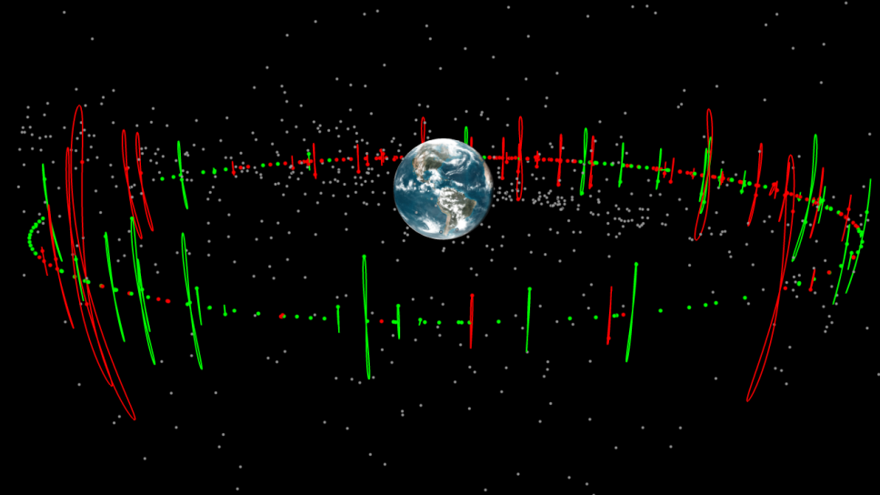
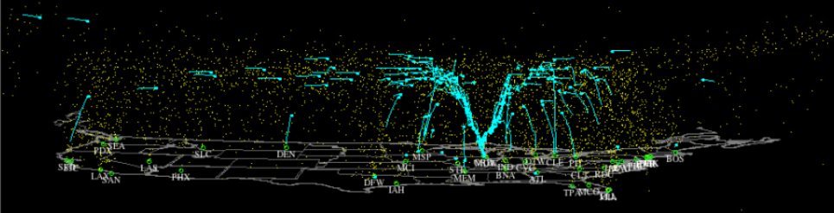

Slide 3
Overview
Capabilities in the Private Sector
Catalog Software Providers
Service Providers
Analysis Software Providers
Current System for Providing SSA Services
Background

Slide 4
Background

Slide 5
Definitions
Space Traffic Management (STM)
Space Situational Awareness (SSA)
Set of technical and regulatory provisions for promoting safe access into outer space, operations in outer space and return from outer space to Earth free from physical or radio-frequency interference
Information about the space environment and activities in space that can be used to:
Operate safely and efficiently
Avoid physical and EM interference
Detect, characterize and protect against threats
Understand the evolution of the space environment
Provide awareness and transparency of space operations

Slide 6
SSA Services
Launch and Early Orbit Collision Avoidance (COLA):
On-Orbit Conjunction Assessment (CA):
On-Orbit Collision Risk Assessment and Maneuver Planning:
Controlled De-Orbit COLA:
End-of-Life (EOL) Verification:
Archive and Analysis:
Comparison of the planned launch trajectory above 150 km from time of launch through the first 48 hours post-launch against all other orbital space objects to determine potential on-orbit conjunctions
Comparison of the orbital trajectory of all active satellites against all other orbital space objects to determine potential on-orbit conjunctions that meet a pre-determined close approach threshold distance
Determination of the probability of collision (P_{c}) of a close approach between an active satellite and another space object, and an assessment of options for maneuvers to minimize or eliminate the probability of collision
Comparison of operator-generated planned de-orbit trajectories against all other orbital space objects and air traffic flight corridors
Monitoring of an active satellite’s end-of-life procedures and verification of compliance with pre-determined orbital debris mitigation plan specified in the operator’s license
Capture and long-term storage of STM events for historical analysis and archival purposes.

Slide 7
Entities Currently Involved in
Provision of SSA Services (US)
Principal Government Entities
  USSTRATCOM/JSpOC
  NASA
Private sector
  Commercial entities, e.g., AGI
  Non-profit - Space Data Association
  FFRDCs - Aerospace Corporation, Lincoln Laboratory/MIT
Notes:
Five Federal agencies—DOD, NASA, FAA, FCC, and NOAA—have roles in the provision of SSA/STM services.
The Air Force’s United States Strategic Command’s (USSTRATCOM) Joint Space Operations Center (JSpOC), has primary responsibility for providing space capabilities for the U.S. military or defense of the United States and provides SSA services for all DOD space assets. JSpOC also provides SSA data and information to domestic, international, and commercial satellite owners/operators on a voluntary basis. 10 USC § 2274 authorizes DOD to provide space situational awareness and information from, non-U.S. Government entities to the extent that it is consistent with the national security interest of the United States. This authority extends to U.S. commercial entities, the government of a foreign country, or a foreign commercial entity. It maintains classified and unclassified versions and shares information in accordance with SSA sharing agreements with both foreign governments and commercial operators. It also provides deorbit and reentry support and disposal/end-of-life support.
NASA: NASA is both a provider and consumer of SSA data. NASA’s Conjunction Assessment Risk Analysis (CARA) Mission at Goddard Spaceflight Center is responsible for the safety of NASA missions and engages in conjunction assessment risk analysis. NASA’s Procedural Requirements for Limiting Orbital Debris (NPR 8715.6A, Section 3.4) requires NASA to use the USSTRATCOM high-accuracy catalog to conduct conjunction assessment analyses for its maneuverable Earth-orbiting spacecraft with a perigee height of less than 2,000 km in altitude or within 200 km of GEO. NASA reports its space events to JSpOC, including launches, maneuvers, and reentries. It also provides information on NASA operational missions to the JSpOC for conjunction assessment purposes. NASA makes its project protection plans available to JSpOC to assist it in identifying vulnerabilities to NASA’s robotic space systems. NASA funds several civil service employees who reside in the JSpOC and are the primary individuals maintaining the high-accuracy catalog and performing CA screenings. NASA has also invested significant resources in its own software and hardware that interface closely with the JSpOC systems and is working on more effectively integrating space weather data into the JSpOC system. NASA also provides these services to the ESA satellites that are part of the A-Train Earth observation constellation.
FAA: The Federal Aviation Administration is a regulator of space launch and reentry transportation carried out within the United States or by U.S. citizens. The FAA/AST exercises this responsibility consistent with public health and safety, safety of property, and the national security and foreign policy interests of the United States. In determining whether to issue a license, the FAA/AST conducts an interagency policy review, a safety review and approval, a payload review and determination, an environmental review, and it sets financial responsibility requirements.
FCC: The FCC is responsible for efficient and effective use of non-Federal spectrum domestically, and internationally it promotes the growth and rapid development of innovative and efficient communication technologies and services. It regulates satellite communications through the licensing radio transmitters in outer space. FCC licenses may contain conditions regarding end-of-life disposal and debris-mitigation practices.
NOAA: NOAA is responsible for operating civil environmental satellites in support of weather forecasting, climate monitoring, ocean and coast observations, and space weather forecasting. It receives SSA services from JSpOC, is an SDA member, and has its own conjunction risk assessment and maneuver planning capability. NOAA is also a regulator of space systems. It is responsible for licensing private remote-sensing space systems. NOAA’s regulations require licensees to provide and operate their systems within certain orbits, submit a plan for post-mission disposition of remote-sensing satellites, and provide a casualty risk assessment for planned post-mission disposals involving atmospheric reentry of the spacecraft.

Slide 8
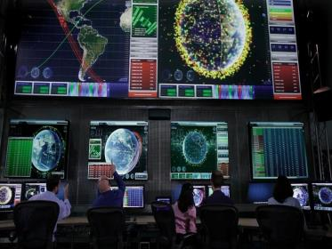
Joint Space Operations Center (JSpOC)
Has the largest network of ground and space-based sensors in the world
Responsible for
  SSA-Metric
  SSA-Spectrum
  Launch/Reentry Warning
  Joint Force Support
  Contingency Operations
Notes:
Personnel Staffing
400+ soldiers, sailors, airmen, marines & allied exchange personnel
~100 staff involved in full SSA including command and control of US military space assets and interfacing with the warfighters (CENTCOM, PACOM, etc).
~20 work to maintain the High Accuracy Catalog (HAC) and conduct conjunction warnings
Approximately 6 crew members working 3 shifts
3-4 to maintain catalog
1 dedicated member focuses on ISS conjunctions
Smaller subset of employees work only on launch and reentry conjunction warnings. These daily responsibilities include:
Characterize 1 space-based infrared event
Characterize ~ 2 space launches (per week)
Forecast/Monitor ~ 3 re-entries (per week)
Forecast/Monitor ~ 1 de-orbit (per week)

Slide 9
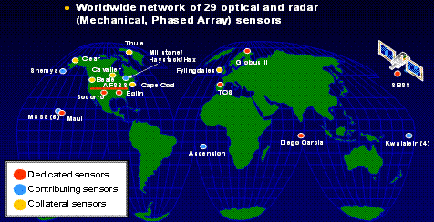
DOD’s Space Surveillance Network
Notes:
JSpOC tasks the Space Surveillance Network (SSN), a worldwide network of 30 space surveillance sensors (radar and optical telescopes, both military and civilian) to observe the objects. The crews match sensor observations to the orbiting objects, catalog, and update the position and velocity of each one. These updates form the Satellite Catalog, a comprehensive listing of the numbers, types, and orbits of all trackable objects in space. https://www.stratcom.mil/factsheets/11/Space_Control_and_Space_Surveillance/

Slide 10
JSpOC Status
JSpOC in midst of a decade long process to replace/upgrade computer systems
  Currently, the computer systems used by JSpOC are the legacy Space Defense Operations Center (SPADOC) and Correlation, Analysis, and Verification of Ephemerides Network (CAVENet) systems, which are in the process of being replaced by the JSpOC Mission System (JMS)
  While JMS is predicted to greatly improve these capabilities over the existing SPADOC and CAVENet systems, its actual performance is still an unknown, and the schedule for delivery has slipped several times
  Currently, the astrodynamics “guts” of JMS are not slated for deployment until October 2016
  Questions remain as to the ability to insert non-DOD requirements into JMS
DOD also updating sensor system to Space Fence from Space Surveillance System (unrelated to launch/re-entry)
DOD/IC is proposing adding a second space control/protection facility in light of rising threats
Notes:
Space Fence is in development and is the replacement of the Space Surveillance System.
When it comes online in 2022 it will provide S-band ground-based radars in the Marshall Islands to track any object larger than a golf ball. This is an improvement from tracking capability of about basket-ball size objects with the Space Surveillance System.
It will cost $914 million

Slide 11
NASA Conjunction Assessment Risk Analysis (CARA) Team
CARA sits within JSpOC to support over 65 NASA missions in LEO, GEO and HEO and all manned space flight missions
JSpOC delivers to the CARA team information on predicted close approaches. The CARA team processes the data and provides a risk assessment.
CARA also plans orbit changes and coordinates with neighboring spacecraft

Slide 12
Analytical Graphics Inc. ComSpOC
Commercial initiative to provide some of the same services as the JSpOC
ComSpOC tracking 5,000+ total space objects, 75% of all active global GEO satellites and 100% of all active GEO satellites over the continental U.S.
  Network of globally distributed optical, radio frequency, radar and space-based sensors - more than 28 optical sensors and one radar site
  DOD’s publicly available data (two line elements)
  Owner/operator data
  International government sensors
~ 3 FTEs required

Slide 13
ComSpOC Sensor Network

Slide 14
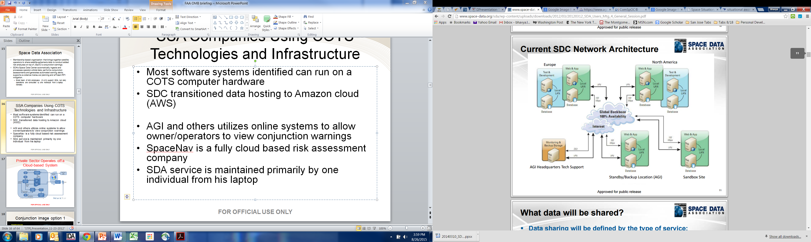
Space Data Association
Membership-based organization that brings together satellite operators to share satellite ephemeris data to conduct added risk analyses on top of JSpOC’s conjunction warnings.
SDA’s Space Data Center (SDC) automatically ingests and processes operator-orbital data; performs conjunction assessments and generates automated warning alerts; supports avoidance maneuver planning and efficient RFI mitigation.
SDC itself is hosted on Amazon Web Services, so it has high availability, backup, redundancy, and expandability.
Notes:
All software systems identified can run on a commodity computer hardware
SDC transitioned data hosting to Amazon cloud (AWS)
AGI and others utilize online systems to allow owner/operators to view conjunction warnings

Slide 15
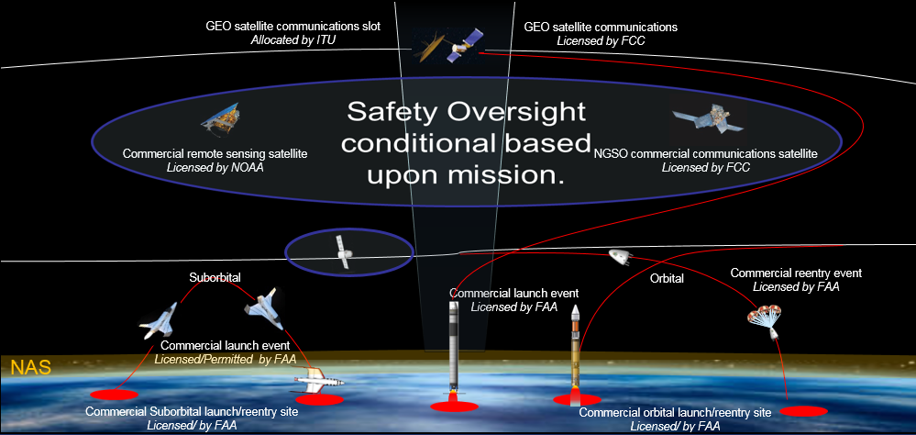
Summary - Today’s SSA Oversight Regime
DOD provides most of the information services
Gap exists for licensing the safety of commercial space transportation in and beyond low earth orbit (LEO)
Potential detrimental effects for emerging commercial space transportation activities

Slide 16
Summary - Gaps in Current System
Incomplete data fusion
  JSpOC currently cannot accept O/O data or data from commercial sensors
  Its CA is therefore not as accurate
JSpOC hamstrung by legacy systems
  JSpOC software and algorithms are old and it takes a long time to upgrade – private sector farther ahead
  Next generation system has already cost $1B+ and it is unclear when it will be ready for use

Slide 17
Assessment of Capabilities in the Private Sector

Slide 18
Users Surveyed
Launch Operators | Satellite Operators | Other
Orbital Sciences | Avanti | Bigelow
Space X | Eutelsat | Boeing
Virgin Galactic | Inmarsat | Lockheed Martin
Blue Origin | Intelsat | Sierra Nevada
XCOR | SES StarOne | Vulcan Aerospace Cal Poly San Louis Obispo

Slide 19
Vendor Organizations Surveyed/Examined
Current and Proposed Products | USG | Private | FFRDC | International (Partial) | Other (Partial)
Services | Joint Space Operations Center (JSpOC) NASA Conjunction Assessment Risk Analysis (CARA) National Oceanic and Atmospheric Administration (NOAA) National Reconnaissance Office (NRO) | Analytical Graphics, Inc. Boeing Space Data Association (SDA) | Aerospace Corporation Massachusetts Institute of Technology (MIT) Lincoln Laboratory (LL) | Center for Advanced European Studies and Research (CAESAR)
Software Analysis Tools | JSpOC NRO | A.I. Solutions AGI Krados Omitron Solers SpaceNav TASC/Engility | MIT/LL | C-S Information Systems
Data Sets | JSpOC NRO | AGI Boeing Exoanalytics SDA |  | European Space Agency (ESA) International Scientific Optical Network (ISON) | Celestrak Union of Concerned Scientists SeeSat

Slide 20
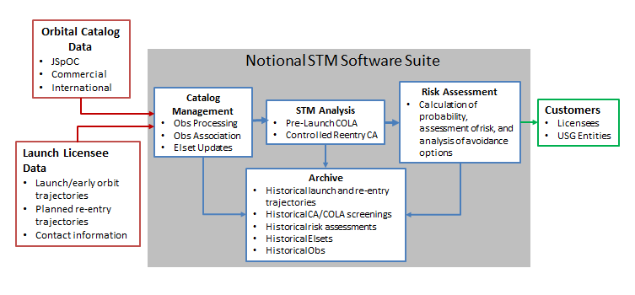
High Level Architecture

Slide 21
Summary of Capabilities in the Private Sector
Explored private sector capabilities in the SSA area
Did not verify/validate capabilities
Catalog Management Software
Analysis Software
Risk Assessment Software
AGI
Omitron
Solers
AGI
Data Providers
AGI
Omitron
Solers
TASC/Engility
CS Solutions
SpaceNav
ExoAnalytics
SDA
Krados
RINCON
MIT Lincoln Lab
A.i. Solutions
Aerospace
Notes:
Products: Software and hardware on a one-time basis to enable independent analyses
Analysis Software (calculating conjunctions)
Analysis enhancing software (addl analysis for risk assessment and determining COLAs)
Catalog maintenance Software (ingesting obs and building/maintaining catalog of objects)
Services: Ongoing provision of results from contractor-produced analyses
Analysis Products
Catalog
Data

Slide 22
Overall Assessment - Data
Many potential sources of observational data
  Likely dozens of individual providers for a certain type of data or from a specific sensor/location
  A few big data “aggregators”
Currently limited to mostly large objects and deep space (above 5,000 km)
  Small space debris in LEO not well covered (for now)
Market for data still immature

Slide 23
Overall Assessment - Software
Only 3 vendors currently provide catalog software
  Mainly due to lack of demand
Multiple vendors can provide astrodynamic analysis software for on-orbit activities
  Only 1 for atmospheric (below 200 km)
One vendor can provide risk analysis/decision software

Slide 24
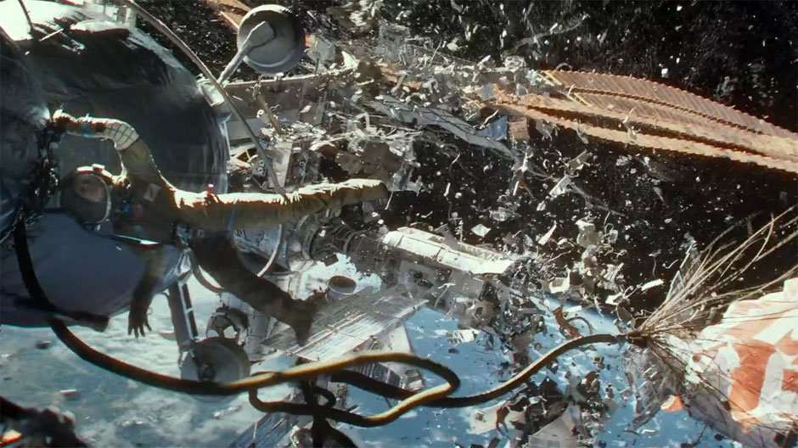
Questions?

Slide 25
STM Data Types
Data Type | Description
Metric | Information about an object's orbital trajectory
Characterization | Information about a space object such as size, tumbling, composition, emissions, and capabilities
Descriptive Information | Information about a space object such as owner/operator (O/O), launch date, Launching State, and mission
Level | Description
1–Raw sensor data | Focal plane images, radar returns
2–Observation | Location of a space object at a point in time relative to a sensor
3–Element Set | Set of variables (function) describing an object's orbital trajectory
4–Ephemeris | Predicted position of an object's position that is generated by propagating an element set over a period of time
5–Analysis Product | Information that is the result of an analysis based on elsets or obs (such as reentry prediction time)

