Slide 1
Sub-Orbital Passenger Aircraft for Space Launch Operations
FastForward Tele-Conference
11 September 2015
Douglas G. Thorpe*
Space Propulsion Synergy Team
Co-founder of theUSAparty.com; Mt. Sterling, KY

Slide 2
Concept & Paper Series
CONCEPT ORIGIN: Originated as a result of Thorpe’s proposal to Darpa’s ALASA program; originally rumored to require 25,000 lb to LEO.
CONCEPT RATIONAL: We determined that typical aircraft achieves cruising speed and altitude within 20 minutes of take-off and that a good portion of its fuel carrying capability couldn’t be transferred to payload capability; therefore, a rocket engine could utilize this fuel carrying capability to increase the aircraft’s speed beyond normal engine capabilities and with no additional increase in aircraft size or MTOW, but aircraft would need to be supersonic
CONCEPT:
Convert “successful” PTP Commercial Passenger aircraft, utilize for ETO missions during “off” shift, convert back to PTP operations in one shift.
Takeoff horizontal and fly the supersonic aircraft to approximately Mach 2-3;
Start rocket engine; turn off air breathing engines after ~20 seconds;
Accelerate to high Mach velocity and high altitude (>100 km) for separation of the upper stage and payload.
Restart jet engines after reentry into the atmosphere for landing.

Slide 3
CONCEPT BENEFITS
COST SAVINGS
Compared to cost of Commercial Medium Class rocket booster ($27M), cost to convert and operate a Suborbital Hybrid Aircraft (that performs the same function) is trivial (<$1M)
Greater utilization of the aircraft (passenger and/or air-freight) lowers the additional cost for ETO launch operations
Lower cost to orbit since only a single upper stage is needed to achieve velocity required for orbit
GREATER RELIABILITY
Upper stage & payload can be returned to launch site safely (Using air breathing engines) if problem occurs with the first stage operation
Aircraft should have higher reliability than pure rocket propelled stages with the use of aircraft high reliability components
Greater launch operational reliability is achieved from the simplicity of the concept (less upper stages; therefore less ascent operations)
GREATER AVAILABILITY
An air launch system that can be converted, operated, and converted back to passenger service in one shift will be able to launch payloads upon demand. Each aircraft could have 100’s missions/yr
LESS TECHNICAL RISK
No aerodynamic shroud or wind loading on upper stage & payload are required since they are jettisoned above 100km altitude (which should also provide lower cost vehicle)
Air launched vehicles are inherently more safer than vertical ground based rockets that require 100% operability until they clear the tower.

Slide 4
Summary
PURPOSE: Provide high-level concept that shows a Hybrid Suborbital Aircraft (HSA) can be used for passenger Point-To-Point (PTP) and Earth-To-Orbit (ETO) operations to achieve remarkable costs reductions
RELATIONSHIP: This work was performed to satisfy the opportunity promoted in Thorpe’s “Space Billets” paper; AIAA 2014-3652
Space Billets = Provide guaranteed large flight rate at very low fixed price
E.g., One hundred 10-ton Space Billets could provide all the propellant for a Mars mission.
Space Billets = $20M; therefore, Mars mission = $2B for transportation costs
IN LATEST WORK: We looked at several supersonic aircraft and validate their performance against our flight simulation program
GOAL OF AIRCRAFT: Transport
300⁺ passengers more than 5,000 miles and
deliver 200,000 lb gross weight upper stage & payload to the Karman line.
200,000 lb upper stage could deliver 40,000 lb to LEO

Slide 5
Latest Findings
What is the optimum flight scheme?
Do we utilize combine cycle / air breathing engines OR utilize turbojet with rocket engines to highest speed and altitude
PTP flight range, flight path, wing loads, and inlet conditions of the different versions of PTP-HSA with same gross weight?
Maximum staging speed & altitude
Airport operations:
How would our vehicle be more of a commercial success than the Concorde?
How do we load LH2, LOX, Liq methane, and Jet-A safely, quickly (less than 30 minutes), and cheaply?
Compare the proposed system with the Andrews Space Peregrine reusable launch vehicle
What are the strategic military advantages of a fleet of 1,000 aircraft?
Is a Mars mission on any given day possible?

Slide 6
Why Include Passenger Service
Much Larger Market: The commercial passenger airline industry absolutely dwarfs the Earth-to-Orbit (ETO) transportation market
($5,000B vs $2B) via 642 million passengers on 8.9 million airline flights each year vs less than 543 to EVER go into space with a maximum of only ~28 commercial space flights each year.
Different Funding Source:
Rather than trying to compete for very limited government funding for the “next greatest launch vehicle”, doesn’t it make more sense to seek private investment funding if we can show a profitable business case?
ETO Cost Savings:
Cost burden to operate an aircraft is known as Aircraft, Crew, Maintenance, & Insurance (ACMI rate or dry lease) cost of aircraft
ACMI rates are $4,600 - $10,000 per flight hour for 737, 747, 757, and MD-80 when dry leased (no fuel) for 250 hours per month and $15,000/hr for a Concorde
Compared to cost of Commercial Medium Class rocket booster ($27M), the ACMI rate is trivial (even compared to a rocket that lands on a barge!)
Using the ACMI rate, we can estimate the total cost of using a Suborbital Hybrid aircraft as less than $2M per launch.

Slide 7
Ground Rules and What We are Trying to Accomplish
Propellants: To cause least impact to airport operations, 1st generation aircraft should use (Jet-A & LOX)
2nd generation aircraft could use liquid hydrogen (LH2) and Jet-A & LOX for greater range.
Aircraft Specifications: The aircraft should be modeled in passenger capacity, Max Take-Off Weight (MTOW), & range after Boeing 2707
300 passengers
675,000 lb MTOW
312,500 lb = 46,575 gallons of Jet-A fuel
9,700 km (6,000 mile) range (the Boeing 2707 had a stated range of only 7,900 km with 275 passengers)
Target average velocity of Mach 4.5 (the Boeing 2707 had maximum speed of Mach 2.7)
Expected Revenue / flight: $400,000 (300 passengers * $1,333 ave ticket price one-way)
Average ticket price of Qantas Flight 7 = $2,400 one-way for 13,800 km
Estimate a 26% premium (higher ticket price) for traveling at Mach 4.5 vs sub-sonic.
6 flights/16 hour work day = $2.4M revenue / work-day vs $2,324,600 for Qantas Flight 7
Flight Profile: Obtain very high altitude & high Mach then glides as far as possible OR cruise @ Mach 5
Maximum development cost of $15B
Minimum fleet size of 75 aircraft ($200M development cost/vehicle); target fleet size of 1,000 ($15M/v)
Be easily modified to launch upper rocket stages or fly passengers on same day
ETO Useful Payload Target 20,000 lb (10 tons) if flown due east from NASA-KSC into 100 mile circular orbit

Slide 8
To achieve these goals
The aircraft must be extremely adaptable by being able to convert from a passenger aircraft into an ETO air launcher and back into a passenger aircraft within one work shift
No horizontal stabilizer (to provide longer platform)
Retractable forward canards (to land at slower speeds)
No retractable wings (to reduce cost and complexity)
Airplane wing should be designed to take advantage of compression lift, such as the wing design by the XB-70 Valkyrie.
A lift-to-drag ratio (L/D) that is at least 75% of the maximum theoretical L/D
Prefer the simpler air inlet technique of the Olympus 593 versus the J-58
But both engines based on designs that are over 50 years old!
Use four to six J-58 engines (or modern equivalent)
Use expander cycle, linear aerospike engines on each wing with multiple combustion chambers for each engine
If placed inside six J-58 engines, aerospike engines would need to produce 250 klb thrust each, so expander cycle may not be possible

Slide 9
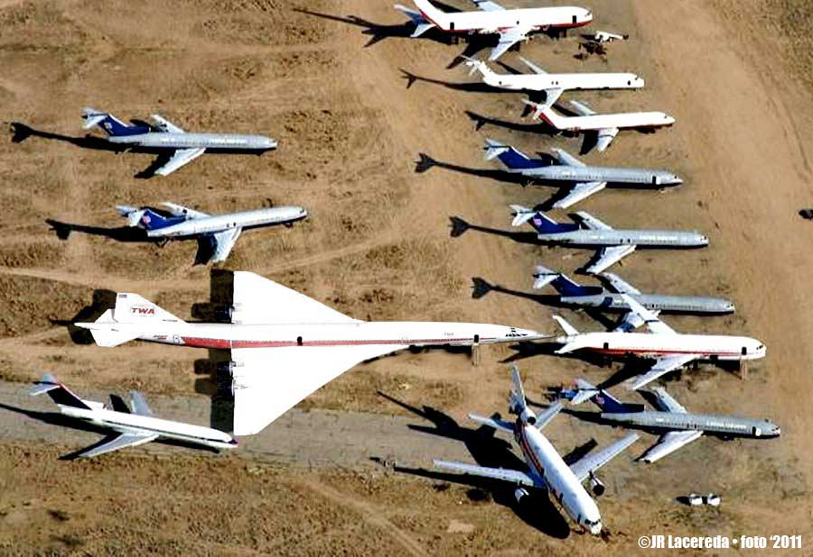
Boeing 2707 in relation in size to common aircraft
Aircraft is much larger than Boeing 787 even though they carry same # passengers because passengers sit 4 & 5 abreast in the 2707, versus 9 abreast in 787. How much extra problems would such a large aircraft cause at airports?

Slide 10
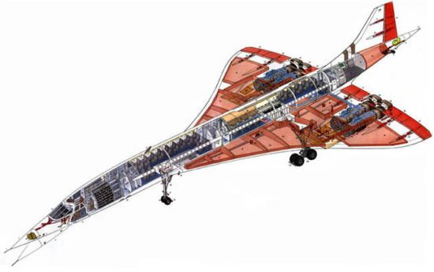
Internal schematic of Concorde showing fuel tanks, engines, & passenger chairs, etc
NOTE: The absence of a rear horizontal stabilizer
The Boeing 2707 design has a fuselage whose diameter varies over the cabin section.
This is done to reduce the interference wave drag between wing and fuselage.
This was not done on the Concorde as it was felt that the increase in production costs would be too high.
For our vehicle, having the same width fuselage is VERY important to how we load and unload aircraft

Slide 11
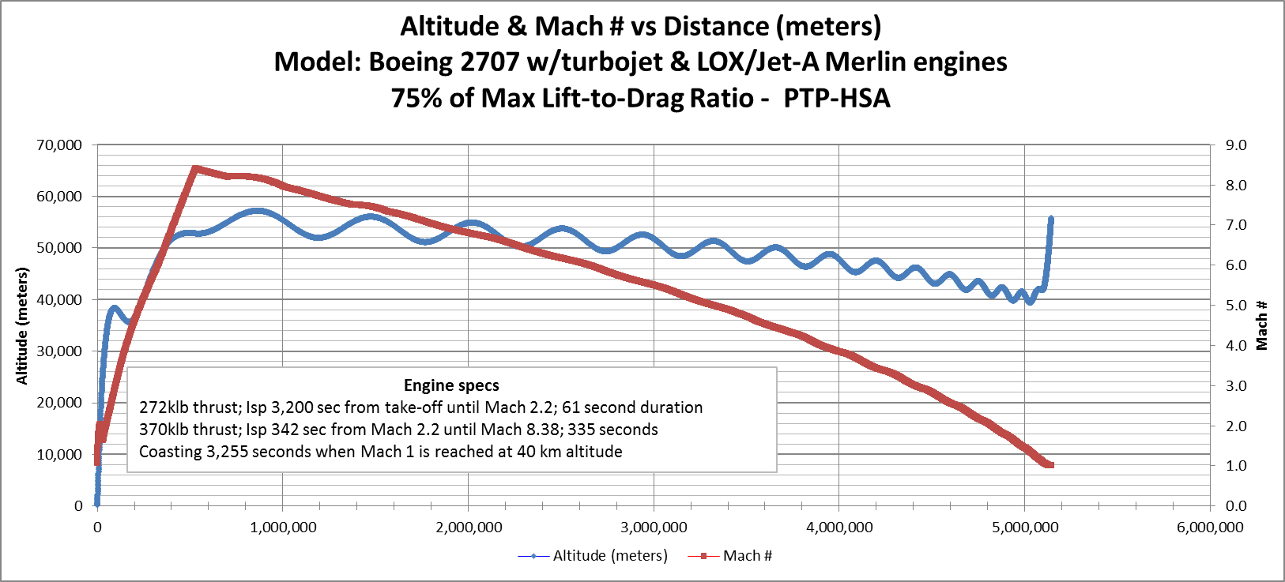
1st Generation Fictitious Boeing 2707 sized aircraft with turbojet and LOX / Jet-A rocket engines
Min L/D = 4.07 at Max speed of Mach 8.38, but all fuel has been consumed; vehicle weighs only 45% of MTOW. As a Result: aircraft experiences same drag it would encounter at Mach 1.49 when fully loaded.
Total Flight Simulation Time: 3,663 seconds = ~61 minutes
Average Mach #: 4.2 = 1,405 m/s
Maximum Altitude: 57km = 187,000 ft = 35.4 miles
Aircraft slowed to less than Mach 1 causing flight simulator program to cause error
Notes:
Nearly all $55,600 (100,260 lb of Jet-A and 267,900lb of LOX) propellants are consumed after aircraft has traveled 3,400 miles in 65 minutes and reached a maximum altitude of 57km (187,000 ft). NOTE: LOX is a renewable energy source that is derived from electricity and costs about $0.04 per pound.

Slide 12
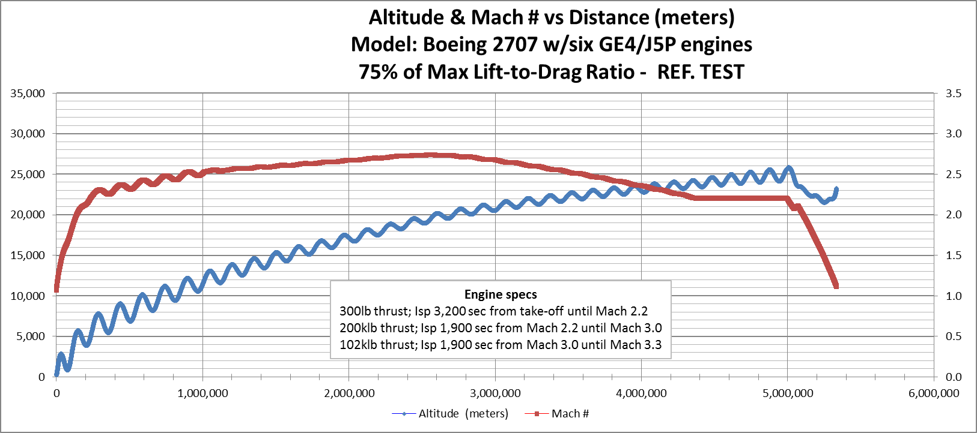
Actual Boeing 2707 with six GE4 engines and no rocket engines
Same Lift-to-Drag ratios at all speeds as before. Max speed = Mach 2.71
Only travels 5,330 km (~3,300 miles) in 127.1 minutes before consuming all fuel
Stated cruising speed and range for the Boeing 2707 is Mach 2.7 and 7,870 km
Could not get the aircraft to climb faster without major porpoising (bouncing).

Slide 13
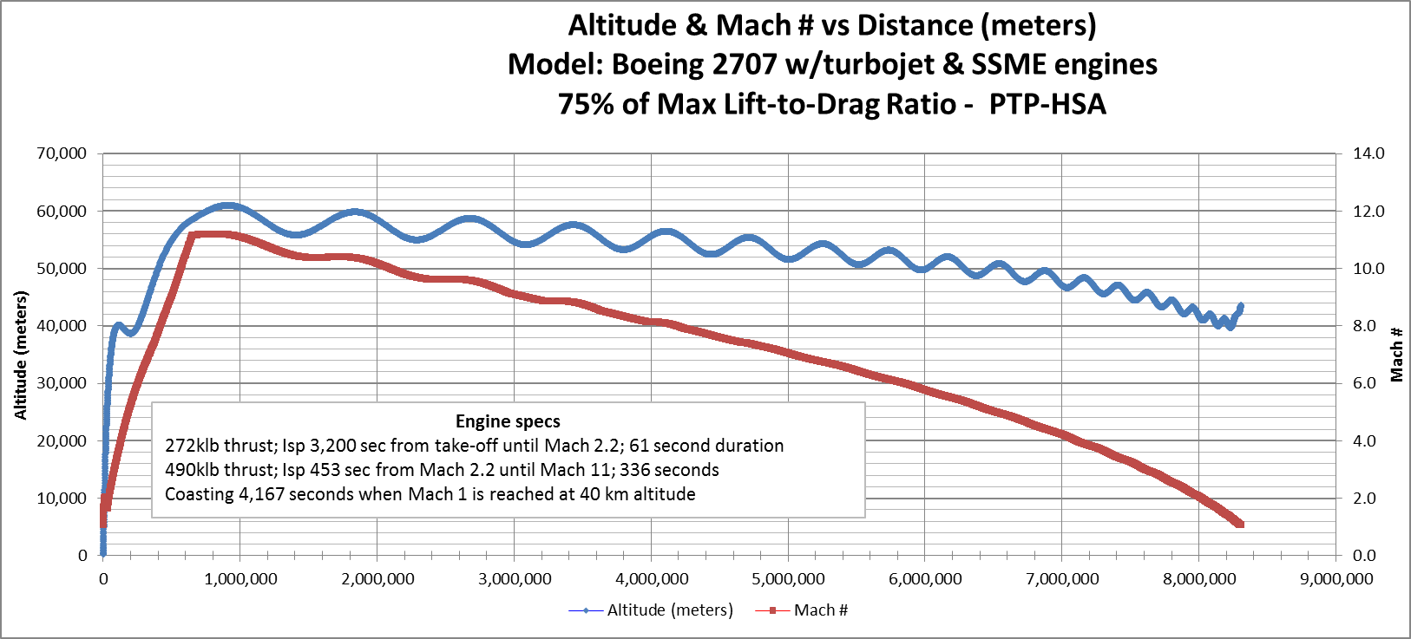
2ndGeneration Fictitious Boeing 2707 sized aircraft w/ turbojet & LOX-LH2 rocket engines
Min. L/D = 3.81, occurs at max. speed of Mach 11.08
Total Flight Simulation Time: 4,580 seconds = >76 minutes
Average Mach #: 5.44 = 1,816 m/s
Maximum Altitude: 61.4km = 201,000 ft = 38 miles
Min. Gravity (straight & level flight): 7.43 m/sec²

Slide 14
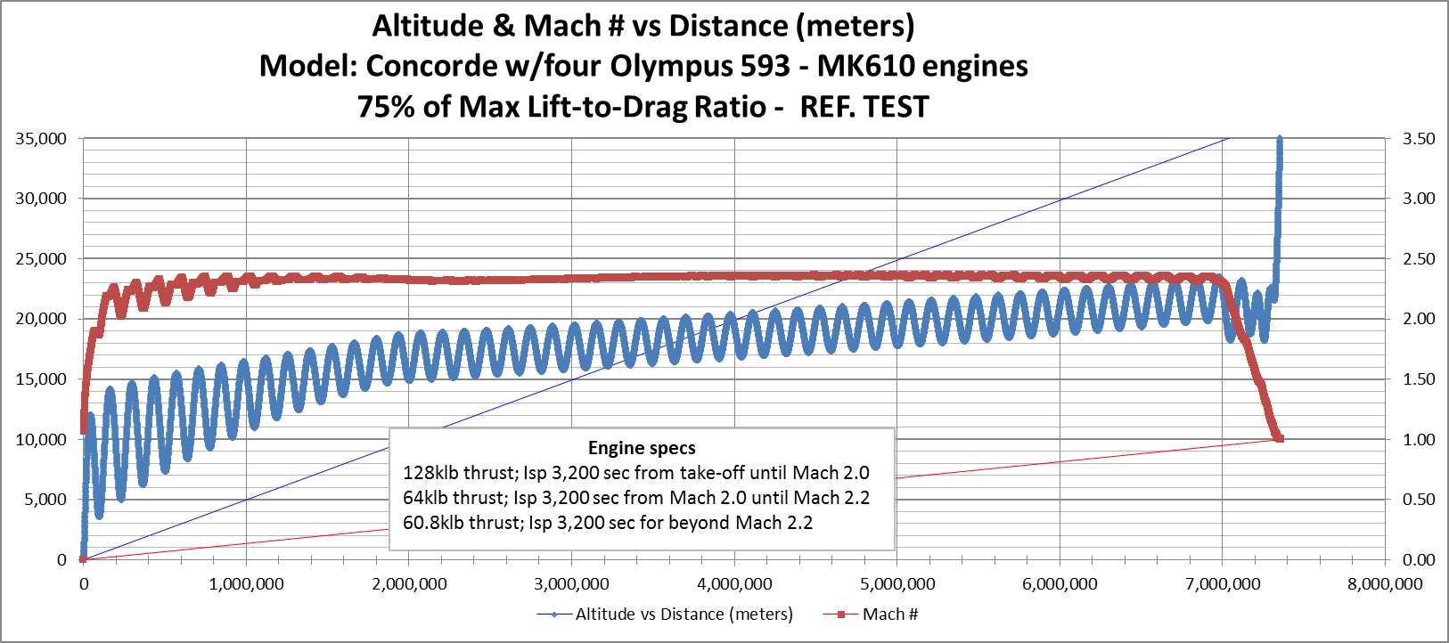
Concorde w/four Olympus 593 – MK610 engines
To authenticate the simulation program, we ran a simulation on the Concorde aircraft.
Found maximum speed = Mach 2.2, range = 7,400 km after 3.26 hours before we ran out of fuel.
Our aircraft exceeded the service ceiling of 18.3 km (60,000 ft) when its weight was reduced from burning fuel.
Normal Concorde maximum speed = Mach 2.2, range = 7,222 km, and a Service Ceiling of 18,300 meters.

Slide 15
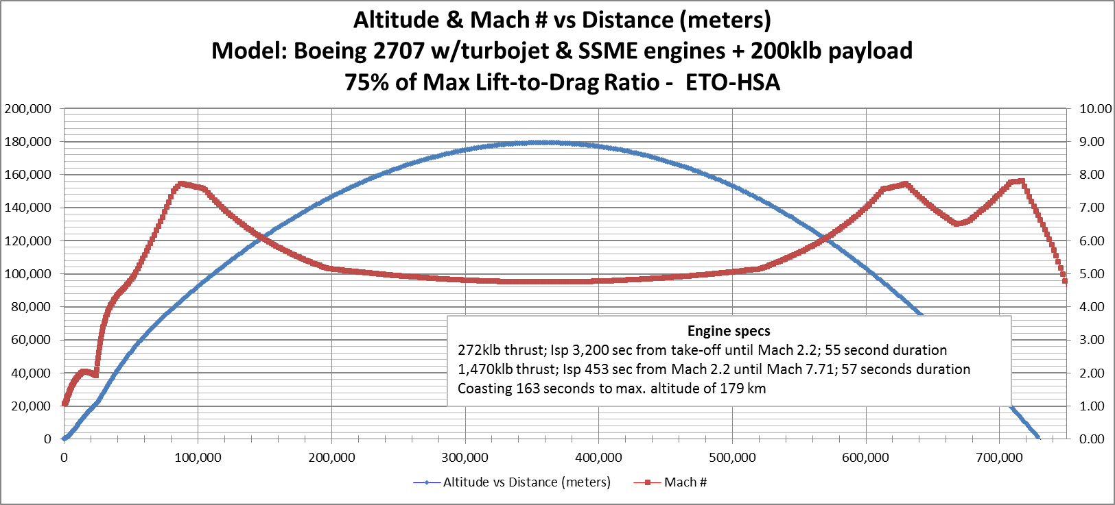
2nd Generation fictitious Boeing 2707 w/turbojet & LH2/LOX engines as Air Launcher
Passenger Service is great, but the point of this paper is to develop an aircraft that can be modified into an air launcher.
Aircraft can deliver 200,000 lb (upper stage & payload) at Mach 7.71 and 179 km altitude
Maximum altitude: 179 km = 587,120 ft = 111.2 miles
1,470 klb thrust LOX/LH2 engines on aircraft only fire for 57 seconds
Space tourists can hitch ride for extended zero-g ride
All passengers and crew eligible for astronaut wings

Slide 16
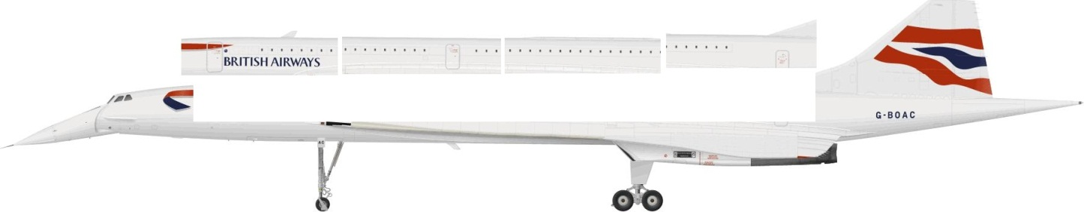
How do we quickly convert a Passenger Aircraft into a Freighter
Start with an aircraft that has a flat fuselage except for flight deck.
Attach four (48 ft long) Passenger Compartment Modules; 75 passengers each
PCM are totally self-contain; include passenger chairs, windows, galleys, bathrooms, HVAC, oxygen, CO2 absorbing LiOH canisters, pressurization system and doorways, & parachutes large enough to support a single PCM.
Passengers SURVIVE mid-air catastrophes.
PCM are removed at airport with passengers & luggage and all are transported together to connecting flight and loaded separately after plane is fueled
Passengers are moved with PCM at connecting airports; no more dashing across airport to catch a connecting flight (for most people)
One of four 48’ long PCM detached for clarity
HSA = 300 ft (Concorde is only 200 ft)

Slide 17
Compare the proposed system with the Andrews Space Peregrine reusable launch vehicle
+ Our system focuses on dual use of the aircraft while the Peregrine is single purpose. As a result:
Our aircraft can be utilized 6 times per day for passenger services and once per night for ETO missions
The Peregrine can only be utilized to carry the 28 commercial missions per year; resulting in much higher fixed cost per mission.
+ Our system has 3 times more thrust from the air breathing engines. Results in 3 x MTOW, --→ our upper stage is > 3 times more massive.
? Our upper stage is deployed from a payload bay
Peregrine is deployed from a bomb bay.
+ Our flat fuselage design will accommodate changes in the Cargo Bay Module for oversized and odd size payloads
Peregrine bomb bay dimensions wouldn’t appear to be easily changed.
+ Our system emphasizes LOX-LH2 upper stage (and LOX-LH2 aircraft rocket engines for the 2nd generation)
Peregrine currently shows only solid rocket propulsion for the upper stage.
+ Our larger total mass to orbit means a totally reusable upper stage can still deliver minimum 10 tons of useful payload to orbit.
Peregrine is 1/3 size and uses less efficient solid propellants for the upper stage, very doubtful if such upper stage system could ever be within an order of magnitude in $/lb of our totally reusable system.

Slide 18
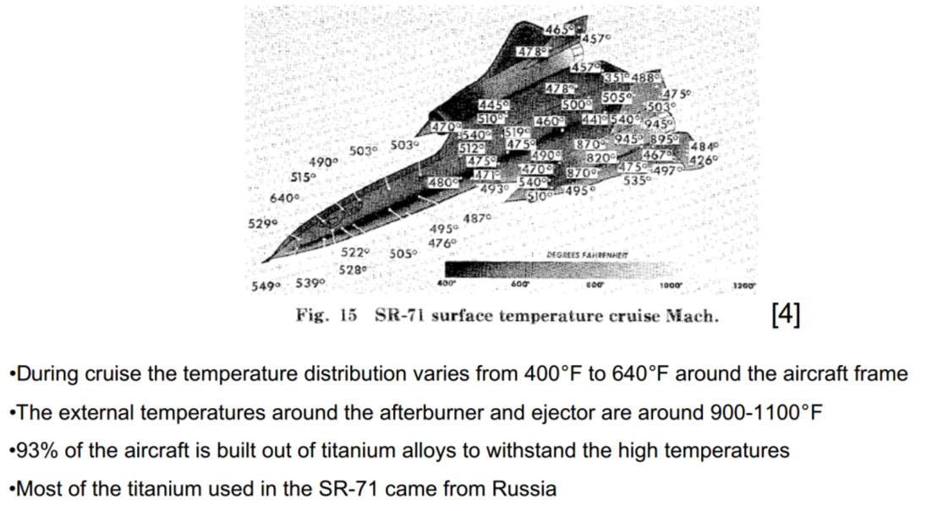
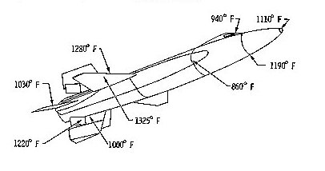
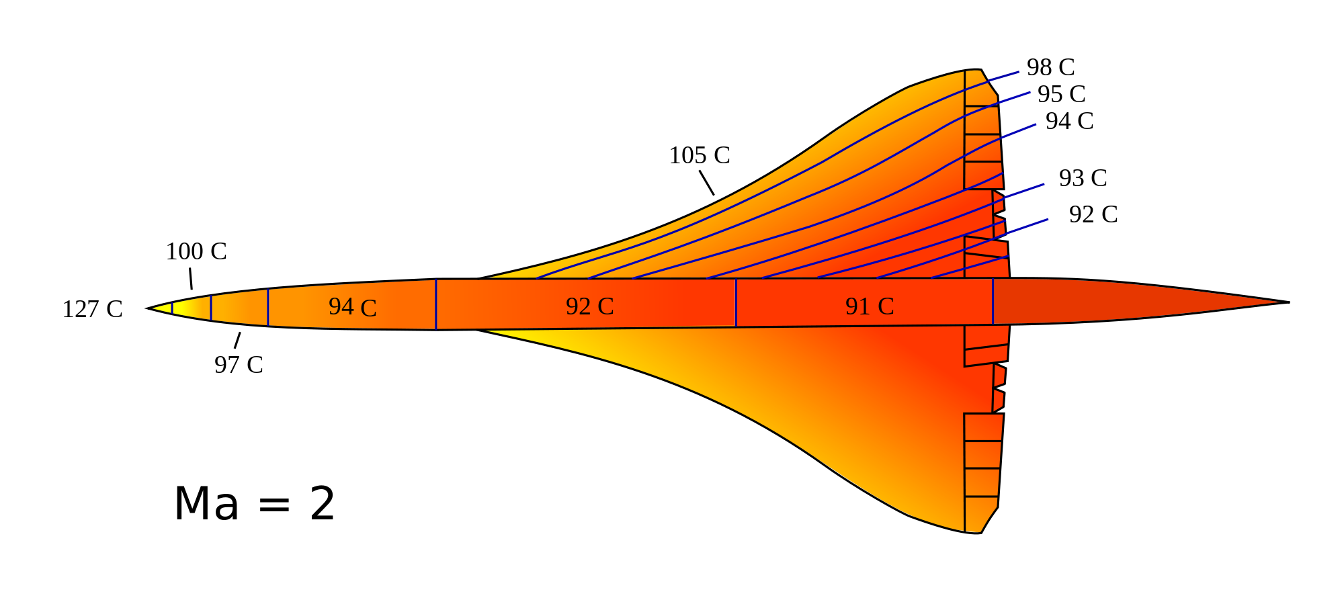
Skin Temperatures on Select Aircraft
Skin Temp of X-15 at Mach 6, above
Skin Temp of Concorde at Mach 2, below

Slide 19
Strategic Military Advantages of civilian PTP-HSA with ETO capability: Fleet of 1,000 aircraft
On any given day: 6,000 sorties will transport 300 passengers at least 4,000 miles (1.8 million passengers daily)
On any given day: 1,000 sorties could take place to remove 1,000 enemy satellites or 1,000 pieces of orbital debris via each sortie spraying tons of water in their pathway
On any given day: 1,000 sorties could launch 1,000 replacement satellites.
One any given day: 1,000 sorties could send 200,000 lb military payloads from above the KARMAN line to fulfill the requirements of SUSTAIN (Small Unit Space Transport And Insertion)
On any given day: 100 sorties could launch a mission to Mars at a fraction of the cost for traditional launch operations;
Instead of launching 10-100 ton SLS rockets,
Launch 100-10 ton payloads to LEO with 1/10th fleet of aircraft
Total Min. Cost = $430M = $4.3M for 10 tons of payload to LEO = $215 per pound
$1.5M for HSA + $2.8M for upper stage.

Slide 20
Next Steps
Obtain project partners & obtain independent verification of concept
Conduct a Business Survey to determine the size of the aircraft and market in order to make a good business case.
Identify Off-The-Shelf parts (e.g., cock pit, landing gear, actuators, sensors, fuel pumps, etc) and their costs
Identify potential air breathing engines
Historic examples are J-58, Olympus 593, and TU-160; none are in production
P&W F135, F119-PW-100, F110-GE-132, F404-IN20, F100-PW-229, RR EJ200, etc
Identify potential rocket engines and RCS thrusters
Even more limited options with a few manufacturers, such as; Pratt & Whitney / Rocketdyne, X-core and Xspace
Identify fuselage, wings, frame, and insulated tank options
Construct CAD drawings and perform CFD analysis of the design
Construct model and perform analysis in hypersonic wind tunnel
Construct Proof-Of-Concept scaled model prototype and launch to high Mach and high altitude
Make construction and production estimates

Slide 21
CONCLUSION
We hope we have provided ample evidence to prove that there is some merit to an aircraft that is propelled by a rocket engine to very high Mach numbers and very high altitude to achieve great average speed and reduced costs.
This paper should provide convincing evidence that such an aircraft would be extremely competitive in the commercial passenger mid-range Point-To-Point markets.
Very recently, Boeing forecast demand for 38,050 new airplanes valued at $5.6 Trillion over the next 20 years.
Very recently, Aviation Week showed the interest in this technology area by posting an article on the German hypersonic airliner program
Now is the time for new American supersonic aircraft to be developed to meet this demand
Now is the time to develop an Earth-To-Orbit supersonic air launcher that can finally move us away from missile technology to a totally reusable ETO system.
We hope that you agree that only because the aircraft is designed for the gigantic commercial PTP passenger market, that there is finally a financial rationale for developing a supersonic air launcher for ETO market.
The next step with this concept is for government and the aviation industry to:
take a closer look,
fund an in-depth study, and
conduct experiments to prove the concept.
Otherwise, passenger service will be stuck at sub-sonic speeds for many years to come, but most importantly, the cost of going into space and the envision of thousands of visitors per year traveling to a space hotel will not be practical with the current foreseeable evolution of missile derived launch systems.

Slide 22
Questions & Comments
Please contact:
Douglas G. Thorpe,
Mt. Sterling, KY
606-723-2289
Kyrocketman@gmail.com
Please see: http://theUSAparty.com
Please see: http://spacepropulsion.org

