Slide 1
Commercial Space Innovation Initiative
Ken Davidian, Director of Research Office of Commercial Space Transportation, FAA
Transportation Research Board, Commercial Space Subcommittee Workshop
7 January 2018

Slide 2
Commercial Space Innovation Initiative Agenda
Assumptions
We agree on the definition of “Commercial Space.”
We agree on the definition of “Innovation.”
What is the 2nd "I" in CSII?
Coordinating Technology Push *and* Pull
CSII value chain diagram of activities
Example CSII activity and research questions
CSII schedule - notional
Conclusion
More info
More info

Slide 3
What is the 2nd “I” in CSII? Strategic management of innovation activities.
Why (Goals)¹
Encourage, facilitate and promote innovative processes & technologies in supporting the advancement of US commercial space transportation
Inform a compelling vision of the future of commercial space as a thriving and self-sustaining economic engine
“Beyond information and data...”
Enable a vision of affordable and reliable spaceflight
“Safe, regular, and routine access, to, from and through space.”
1. From 28 July 2017 CSII Meeting Minutes taken by Aerospace Corp.

Slide 4
What is the 2nd “I” in CSII? Strategic management of innovation activities.
How (Processes)
Partnering of government, academic, private organizations
Selected activities of industry development in targeted areas of resource under-investment.
Performance goal primacy (i.e., technical, economic, academic goals over political, ego, parochial goals)
Management of innovation process paradoxes competition-cooperation / government support-obstruction / technology push-pull
Who?

Slide 5


Coordinating technology push *and* pull
Increased regulatory sophistication (e.g., streamlining)
Increased research in focused areas
Maximum effectiveness through coordinated activities
“Unless the government coordinates its technology push and pull initiatives through some form of project organization that cuts across several of its agencies and departments, its intervention can never be tailored to the risk context of an emerging industry.”²
This is why FAA AST is uniquely situated to lead the CSII.
2. Chakravarthy, B. S. (1985). Business-government partnership in emerging industries: Lessons from the American synfuels experience. Advances in Strategic Management, 3, 257–275.

Slide 6
CSII value chain diagram of activities “Activities provide the bridge to implementation”³
Knowledge-sharing events (Junior Staff) conferences, meetings, workshops, lessons learned, public affairs
Coordination (Senior Executives) strategic planning, membership, policy recommendations
Management & quality assurance (Senior Staff) activity mgt, r&a assessments, accomplishment recognition
Research & analysis activities (Senior Researchers, Students) operational, technical, human, & industry/regulatory topics
3. Porter, M. E. (1985). Competitive advantage: creating and sustaining superior performance. New York, NY: Free Press.

Slide 7
Example CSII activity and research questions
Industry Phase Problems
Phase Interface Problems
Phase 1 - Scientific Discovery (invention): What technologies or models need to be developed? How to develop them?
Phase 2 - Product Development (innovation): What are the processes and determinants of this phase?
Phase 3 - Market Creation (diffusion): What are the processes and determinants of this phase?
Phase 1 to 2: What are the processes of this transition? Are these problems of knowledge transfer, type, or production?
Phase 2 to 3: What are the processes of this transition? How can the probability of transition success be maximized?
Phase 3 to 1: What are the processes of this transition?

Slide 8
CSII outcomes
Tangible Products
New technologies (e.g., prototypes)
New knowledge (e.g., journal articles)
Intangible Products
Creating an interdisciplinary research forum
Leveraging activities of others
Mentoring and developing industry members (incl. faculty, students, employees, managers)

Slide 9
CSII schedule – notional⁴
IN WORK...
Initial Planning | Coordination with Initial Members | Public Announcement | Phase 1 | Future Phases
August 2017 Framework Template FAA approval on: Vision Story Goals Tenets Members MOU scope Program Plan Define schedule & execution plan | Sept 2017 Initial Framework Template FAA approval on: Vision Story | Late Sept – Early Oct 2017 Framework Template FAA approval on: Vision Story | Nov 2017 – Feb 2018 Framework Template FAA approval on: Vision Story | FY2019 Framework Template FAA approval on: Vision Story
 |  | Oct 2017 – Aug 2017 | March 2018 – Sept 2018
4. From 28 July 2017 CSII Meeting Minutes taken by Aerospace Corp.

Slide 10
Conclusion
CSII will draw membership from the commercial space economy, including government, academia, private sector actors.
CSII will strategically coordinate activities designed to stimulate commercial space industry innovation.
FAA AST is ideally situated to coordinate CSII efforts because of its authority to effect technology push *and* pull activities.

Slide 11
Backup Information

Slide 12
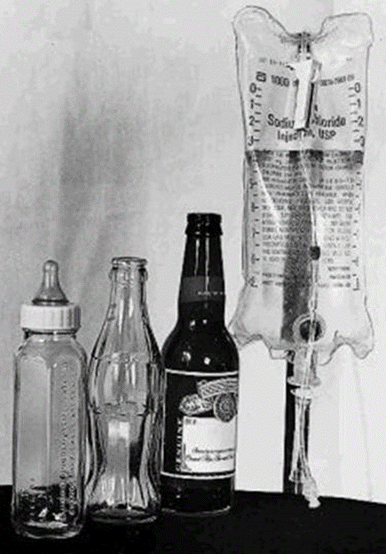
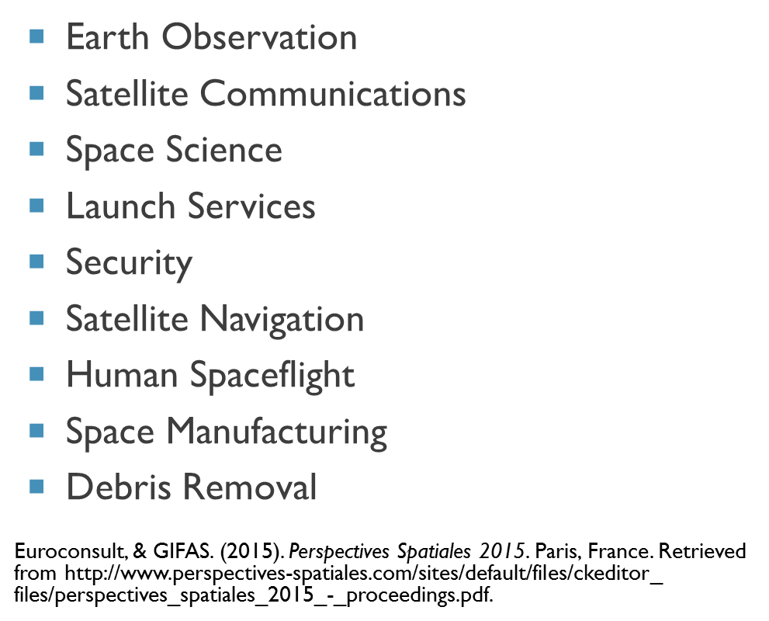
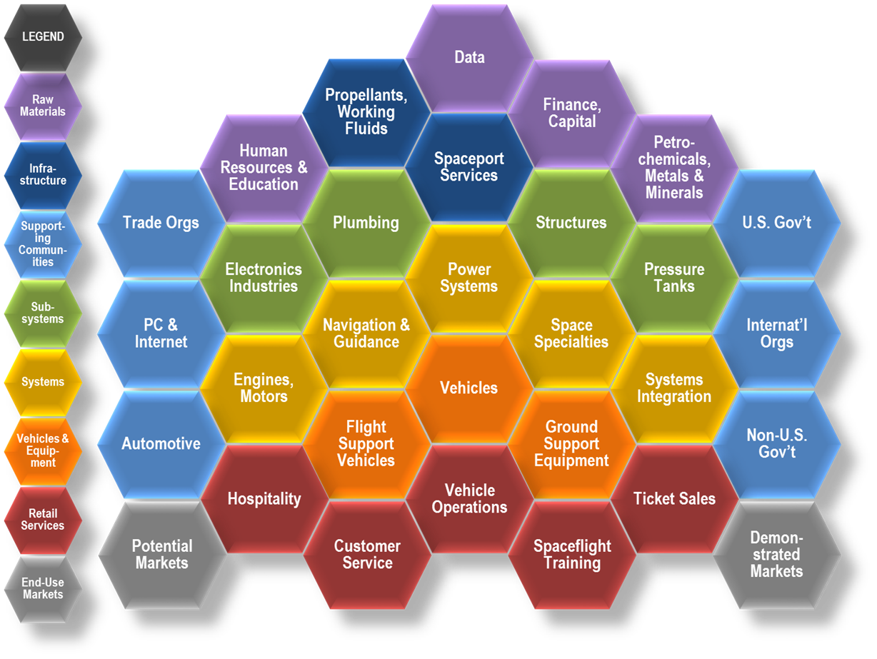
What is “commercial space”? How is it different from “space exploration”?
Commercial Space (CS) includes many sectors and sub-sectors
Industries that support CS
CS and space exploration are similar, but different
Commercial Space
Space Exploration

Slide 13
What is innovation? It is a process...
(Van de Ven, Angle, and Poole, 2000, p. 9)
of motivating and coordinating people ...
to develop and implement new ideas ...
by engaging others in transactions (or relationships) and ...
making the adaptations to achieve desired outcomes ...
within changing institutional and organizational contexts.

Slide 14
... of motivating & coordinating people...
People are both contributors and inhibitors of innovation
Organizational context enables and motivates innovation
Pay (a proxy for recognition)
Awards (individual ~ for radical ideas, group ~ for incremental implementation)
Three phases of innovative group development
euphoric start-up
concerns & transitions
blame or celebration
Another question: How does organizational structure influence innovation?

Slide 15
... to develop and implement new ideas...
the process of developing and implementing a new idea.
a recombination of old ideas
a scheme that challenges the present order
a formula or a unique approach that is perceived as new by the individuals involved (Zaltman, et al., 1973; Rogers 1982)
technical innovations (new technologies, products, and services)
administrative innovations (new procedures, policies, and organizational forms)
Another question: How are innovation ideas developed?

Slide 16
... by engaging others in transactions (or relationships)...
Include
Collegial and hierarchical relationships
Resource allocation proposals and commitments
Quid pro quo arrangements with individuals, units, organizations (subcontracts, co-ventures, etc.)
Stages: negotiations, agreements, and administration
Progression is non-linear
Level of novelty and risk affect transaction trust, cost, complexity, chance of success

Slide 17
... making the adaptations to achieve desired outcomes...
successes and mistakes only identifiable ex post
based on changing, contradictory, and nonlinear criteria
resulting in rational and superstitious learning
requiring the “management of paradox” and contradictory organizational reactions
resulting in purposely vague and general goals
Another question: How do innovation outcomes change?

Slide 18
...within changing institutional and organizational context.
The institutional environment, the larger industry community
Infrastructure resources created by the public sector, aka “public goods” (e.g. norms, knowledge, financing, human resources)
Appropriated and converted by the private sector into “private goods” through innovation
Paradoxes of competition-cooperation, government support-obstruction, technology push-pull

Slide 19
Why and how (by what processes) do innovations develop?
How and why do innovations actually develop over time from concept to implemented reality?
What innovation processes lead to successful and unsuccessful outcomes?
To what extent can knowledge about managing innovation and change processes be generalized from one situation to another?

Slide 20
Innovation assumptions & observations
(Van de Ven, Angle, and Poole, 2000)
Concept | What is Assumed... | What is Observed...
Ideas | One invention, operationalized | Reinvention, proliferation, reimplementation, discarding, and termination
People | An entrepreneur with fixed set of full-time people over time | Many entrepreneurs, distracted, fluidly engaging and disengaging over time in a variety of organizational roles
Transactions | Fixed network of people/firms working out details of an idea | Expanding and contracting network of partisan stakeholders diverging and converging on ideas
Context | Environment provides opportunities and constraints on innovation process | Innovation process constrained by and creates multiple enacted environments
Outcomes | Final result orientation; a stable new order comes into being | Final result may be indeterminate; multiple in-process assessments and spinoffs; integration of new orders with old
Process | Simple, cumulative sequence of stages or phases | From simple to multiple progressions of divergent, parallel, and convergent paths, some of which are related and cumulative, others not

Slide 21
WHO: CSII Membership
Private-sector organizations
Firms, trade organizations, market non-profits
Public-sector organizations
US government departments and agencies (e.g., DOC, DoD, NASA, FCC, FFRDCs, etc.)
State and local government departments and agencies
Universities to conduct CS research
International entities
Include external participants to counter "groupthink"

Slide 22
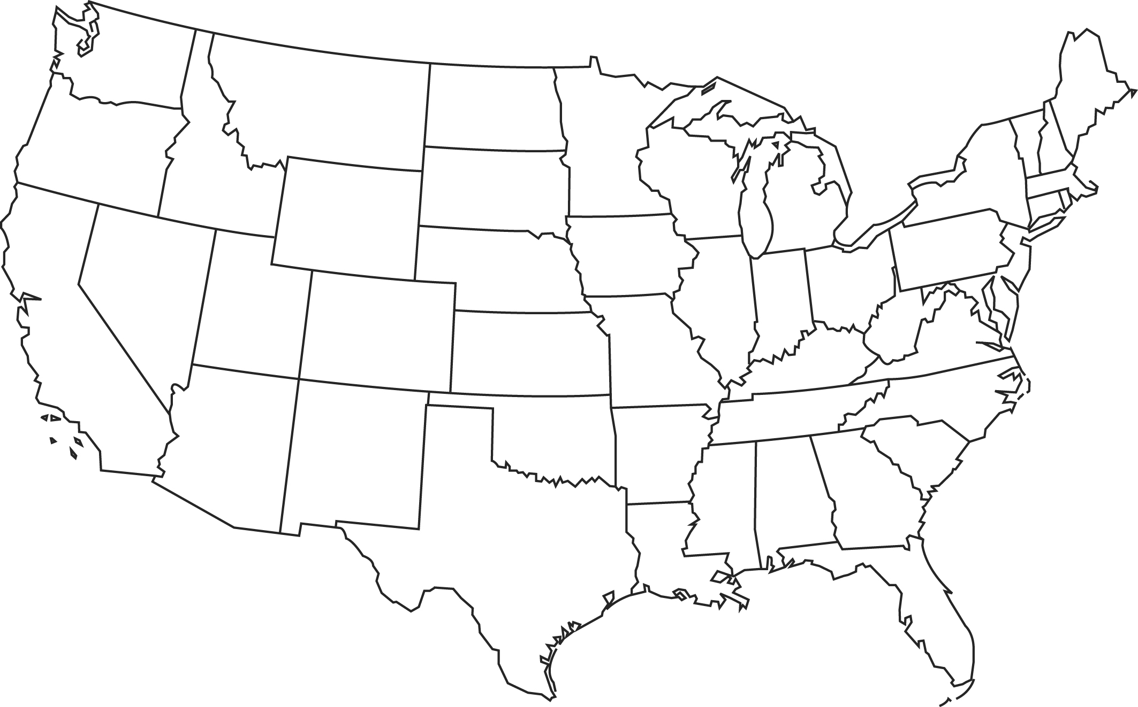
CSII Member Locations
1
1
2
1
2
2
KEY
¨ | CURRENT
¡ | COE CST (potential)
 | Other (potential)
1
1
2
4
2

Slide 23
Innovation modeled as simple phases or stages
Commercial development is built upon three phases:¹
basic research (discovery of scientific knowledge)
the creation of a product (the innovation process)
offering that product for sale (diffusion).
These are the three phases of industry development⁵
Commercialization can be impacted by different policies, activities, and events, undertaken by all CS economy actors
5. Schumpeter, J. A. (1934). The theory of economic development. Cambridge. MA: Harvard.

Slide 24
Scientific Discovery
Market Creation
Product Development
How can market information impact SCIENTIFIC DISCOVERY?
SCIENTIFIC DISCOVERY is the result of non-proprietary research activities.
MARKET CREATION includes marketing, demonstrations, change agents, education, etc.⁶
What happens when PRODUCT DEVELOPMENT cannot succeed in MARKET CREATION?
Three types of problems may exist between SCIENTIFIC DISCOVERY and PRODUCT DEVELOPMENT: problems of knowledge transfer, type, or production.⁷
PRODUCT DEVELOPMENT is conducted during the pre-production phase involving proprietary research activities.
6. E.g., Rogers, E. (2003). Diffusion of innovation (5th ed.). New York, NY: New York: Free Press.
7. Van de Ven, A. H., & Johnson, P. E. (2006). Knowledge for theory and practice. Academy of Management Review, 31(4), 802–821.

Slide 25
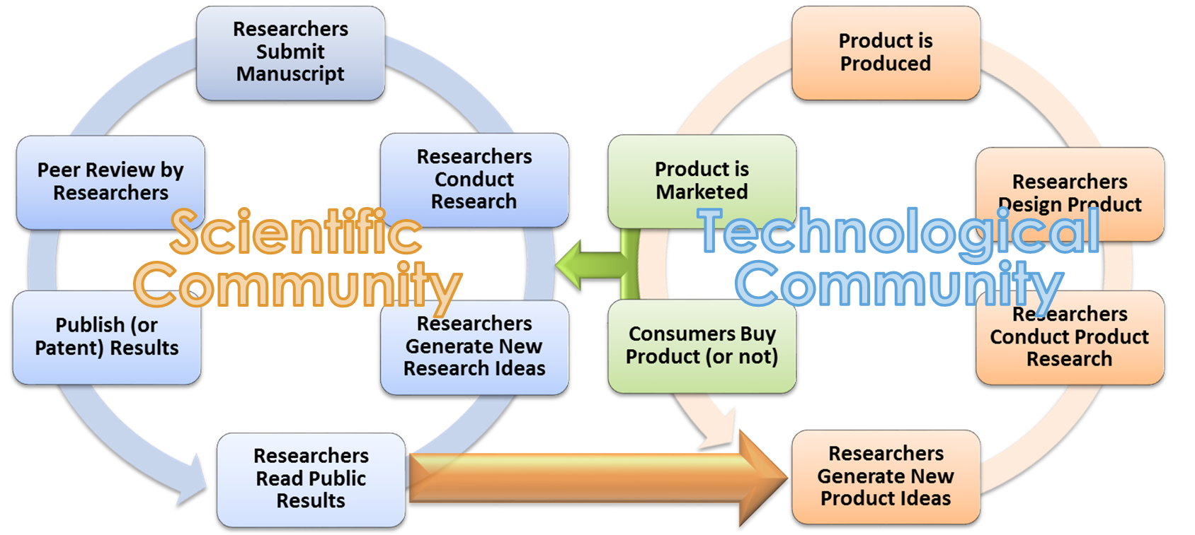
Theory: From discovery to diffusion
The discovery/invention (blue), innovation (orange) , diffusion (green) model presented here is just one of many depictions.”⁸
8. Debackere, K., Clarysse, B., Wijneberg, N. M., & Rappa, M. A. (1994). Science and industry: a theory of networks and paradigms. Technology Analysis & Strategic Management, 6(1), 21–38.

Slide 26
Final Thoughts... Van de Ven, A. H., & Poole, M. S. (2000). An introduction to the Minnesota innovation research program. In A. H. Van de Ven, H. L. Angle, & M. S. Poole (Eds.), Methods for studying innovation process (pp. 3–30). New York, NY: Oxford University Press on Demand.
“As Teece (1987: 3) argues, ‘at a time when so much attention is given to innovation and entrepreneurship, it is rather pathetic that a deep understanding of the process is lacking. It is no wonder that firms and governments have difficulty trying to stimulate [and manage] innovation when its fundamental processes are so poorly understood.’” (p. 1).
“Tornatzky et al. (1983) point out that while many studies have examined the antecedents (facilitators/inhibitors) to or consequences (outcomes) of innovation, very few have directly examined how and why innovations actually emerge, develop, grow, or terminate over time” (p. 4).

Slide 27
Final Thoughts... Van de Ven, A. H., & Poole, M. S. (2000). An introduction to the Minnesota innovation research program. In A. H. Van de Ven, H. L. Angle, & M. S. Poole (Eds.), Methods for studying innovation process (pp. 3–30). New York, NY: Oxford University Press on Demand.
“the innovation manager needs a ‘road map’ that indicates how and why the innovating journey unfolds and what paths are likely to lead to success or failure” (p. 4).
“Although such a process theory may never reach the precision to tell managers exactly what to do and how an innovation will turn out, it may produce some fundamental ‘laws of innovating’ useful for describing and explaining a broad class of processes, sequences, and performance conditions central to the management of innovation” (p. 4).

