Slide 1
Small Launch Vehicles
A 2017 State of the Industry Survey
Carlos Niederstrasser @rocketscient1st
Warren Frick
Copyright © 2018 by Orbital ATK, Inc.
7 January 2018
Corrections, additions, and comments are welcomed and encouraged!

Slide 2
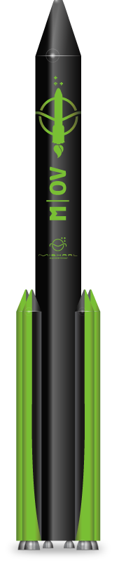

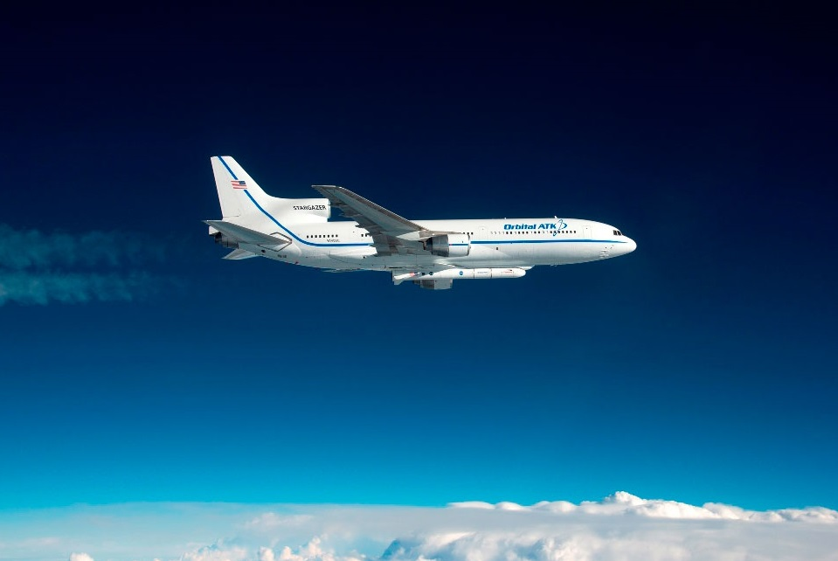
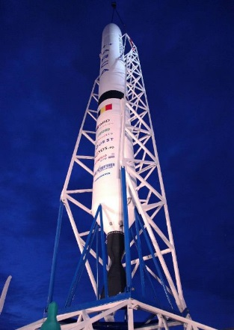
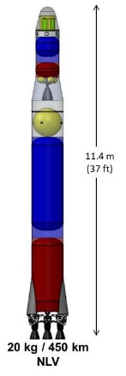
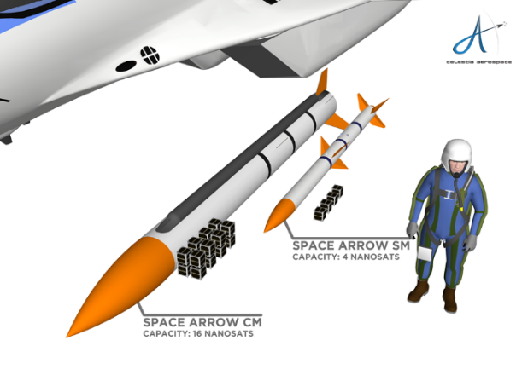
Dawn of a New Era?
There are more than 70 Small (< 1000 kg) to LEO Rockets Flying or in Development

Slide 3
Listing Criteria
Have a maximum capability to LEO of 1000 kg or less (definition of LEO left to the LV provider).
The effort must be for the development of an entire launch vehicle system (with the exception of carrier aircraft for air launch vehicles).
Mentioned through a web site update, social media, traditional media, conference paper, press release, etc. in the past 3 years.
Have a stated goal of completing a fully operational space launch (orbital) vehicle. Funded concept or feasibility studies by government agencies, patents for new launch methods, etc., do not qualify.
Expect to be widely available commercially or to the U.S. Government
No specific indication that the effort has been cancelled, closed, or otherwise disbanded.
Corrections, additions, and comments are welcomed and encouraged!
Notes:
No value judgment on viability or credibility. 2010 date used as proxy to determine whether they are still active. May not be overly public due to funding, confidentiality, etc. Do not include Iranian or Israeli launch vehicles.

Slide 4
We did not …
… Talk to the individual companies
… Rely on any proprietary/confidential information
… Verify accuracy of data found in public resources
  Primarily relied on companies’ web sites
Funding sources, when listed, are not implied to be the vehicles sole or even majority funding source.
We do not make any value judgements on technical or financial
credibility or viability

Slide 5
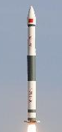
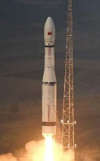
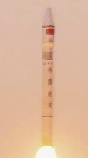
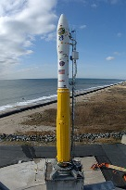
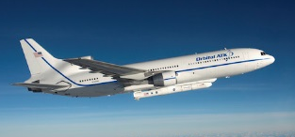
Five Operational Systems
Organization | Vehicle Name | Country | First Launch
China Aerospace Science and Industry Corporation | Kuaizhou-1A | China | 9 Jan 2017
China Aerospace Science and Technology Corporation | Chang Zheng 11 | China | 25 Sep 2015
China Aerospace Science and Technology Corporation | Kaituozhe-2 | China | 3 Mar 2017
Orbital ATK | Minotaur I | USA | 27 Jan 2000
Orbital ATK | Pegasus XL | USA | 5 Apr 1990

Slide 6
Under Development
Organization | Vehicle Name | Country | Latest Launch Date | 2015 Status | 2016 Status
Aphelion Orbitals | Helios | USA | 2021
ARCA Space Corporation | Haas 2CA | USA | Q3 2018 | Active | Active
Bagaveev Corporation | Bagaveev | USA |  |  | Active
bspace | Volant | USA | 2018 |  | Active
Celestia Aerospace | Sagitarius Space Arrow CM | Spain | 2016 | Active | Active
Cloud IX | Unknown | USA
CONAE | Tronador II | Argentina | 2020 |  | Active
CubeCab | Cab-3A | USA | 2019 | Active | Active
Departamento de Ciencia e Tecnologia Aeroespacial | VLM-1 | Brazil | 2019 |  | Watch
ESA | Space Rider | Europe | 2020
Gilmour Space Technologies | Eris | Australia/Singapore | Q4 2020 |  | Watch
Heliaq Advanced Engineering | Austral Launch Vehicle | Australia |  |  | Watch
Interorbital Systems | NEPTUNE N1 | USA |  | Active | Active
ISRO | PSLV Light | India | Q1 2019
LandSpace | LandSpace-1 | China | Q4 2017 |  | Active
LEO Launcher | Chariot | USA | Q4 2018
Lin Industrial | Taimyr-1A | Russia | Q1 2020 | Active | Active
Linkspace Aerospace Technology Group | NewLine-1 | China | 2020
One Space Technology | OS-M1 | China | 2018 |  | Watch
Orbex | Proprietary | United Kingdom
Orbital Access | Orbital 500R | United Kingdom | 2020 |  | Active
PLD Space | Arion 2 | Spain | 3Q 2021 |  | Active
Rocket Lab | Electron | USA/New Zealand | 2017 | Active | Active
Rocketcrafters | Intrepid-1 | USA | Q1 2019 |  | Active
RocketStar | Star-Lord | USA | 2018 | Watch | Evolution
Scorpius Space Launch Company | Demi-Sprite | USA |  | Active | Active
Skyora | Skyora XL | UK/Ukraine
SpaceLS | Prometheus-1 | United Kingdom | Q4 2017 |  | Active
Stofiel Aerospace | Boreas | USA |  |  | Watch
Stratolaunch | Pegasus XL | USA |  |  | Watch
Tranquility Aerospace | Devon Two | United Kingdom |  |  | Active
VALT Enterprises | VALT | USA |  | Watch | Active
Vector Space Systems | Vector-R | USA | 2018 |  | Active
Virgin Orbit | LauncherOne | USA | H1 2018 | Active | Active
zero2infinity | Bloostar | Spain | 2017 | Active | Active

Slide 7













Country of Origin
Country | Count
USA | 18
China | 6
United Kingdom | 4
Spain | 3
Russia | 1
Argentina | 1
Brazil | 1
UK/Ukraine | 1
Australia/Singapore | 1
Australia | 1
USA/New Zealand | 1
Europe | 1
India | 1

Slide 8
How Small is Small?

Slide 9
Next Generation Launch Costs
Assumptions:
Lowest cost in range given
Highest performance in range given
No attempt to normalize for differing definitions of LEO
No attempt to ensure services provided are equivalent
Comparison:
Falcon 9 (pre-flown): ~$2.8k / kg

Slide 10
Funding Sources
Organization | Funding Source
Aphelion Orbitals | Angel investors
ARCA Space Corporation | Individual private investors
Bagaveev Corporation | Tim Draper, Adam Draper, DCVC, New Gen Silicon Valley Partners, Wei Guo, Data Coolective, Sand Hill Angels
Celestia Aerospace | One signed up customer
CubeCab | Biz Plan Competition, Self funded
ESA | ESA
Gilmour Space Technologies | Blackbird Ventures, 500 Startups
Interorbital Systems | Self, Presales
LandSpace | Angel Investors
Lin Industrial | Sergei Burkatovsky
One Space Technology | Legend Holdings, HIT Robot Group at Harbin Institute of Technology, Chun Xiao Capital, Land Stone Capital
Orbex | High-Tech Gründerfonds, private investors, the UK Space Agency and the European Commission Horizon 2020 programme
PLD Space | Spanish government, EC, Caixa Capital Risc, Gobierno de Aragon, GMV, ESA, Gonzalo de la Pena
Rocket Lab | NZ Gov, Kholsa, VBP, K1W1, LM, Promus Ventures, Bessemer, Data Collective
Rocketcrafters | State of Florida, DARPA
Stratolaunch | Paul Allen
VALT Enterprises | Office of Naval Research, Mainte Space Grant
Vector Space Systems | Seed Angels, NASA, DARPA, Space Angels, Sequoia Capital
Virgin Orbit | Virgin Group; Aabar Investments; Sauid Arabia
zero2infinity | Pre sales, Investors, Caixa Capital

Slide 11
Launch Vehicle Individual Summaries
The new crowd of small launch vehicle incorporate a wide spectrum of propellants, launch methods, and other unique attributes that are designed to provide that winning edge over competitors. In the following summaries, we attempt to outline some of unique attributes various vehicles
Note: Not all vehicles are shown. No specific criteria were used for inclusion in the next few slides. Goal is to illustrate wide variety of new approaches.

Slide 12
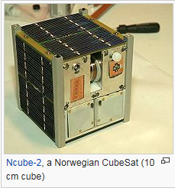
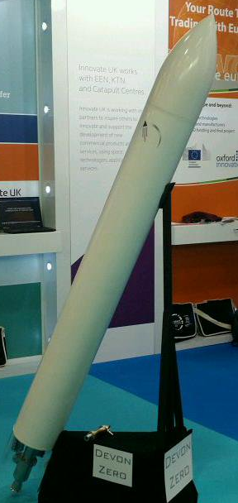
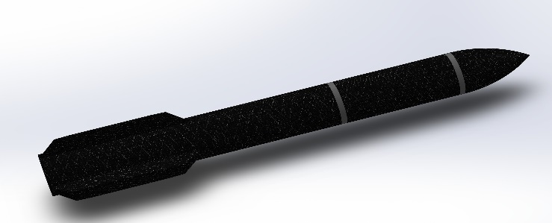
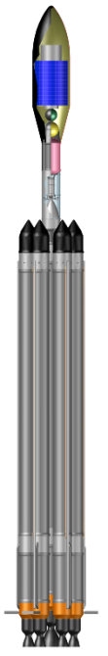

CubeSat Launchers
Courtesy of Wikipedia
Devon Two is a fully reusable ground launched hydrogen peroxide LOX vehicle with 3U capabilities from Tranquility Aerospace
Cab-3A is an F-104 Starfighter air-launched vehicle with 3U capabilities from CubeCab
Devon Zero Vehicle
NEPTUNE N1 is a multi-stage pressure fed turpentine ground launched vehicle with single common core using white fuming nitic acid oxidizer with 6 kg capabilities from Interorbital Systems (No picture available)
Cab-3A
Bagaveeev is 2 stage liquid vehicle with pressure fed 3D printed engines and ground or sea launch platform with 10kg capabilities from Bagaveev Corporation
Taymyr is a line of 2 stage pressure fed multiple core H2O2/RP-1 vehicles with 10+kg capabilities from Lin Industrial
Taymyr Vehicle
Bagaveev Test Vehicle

Slide 13
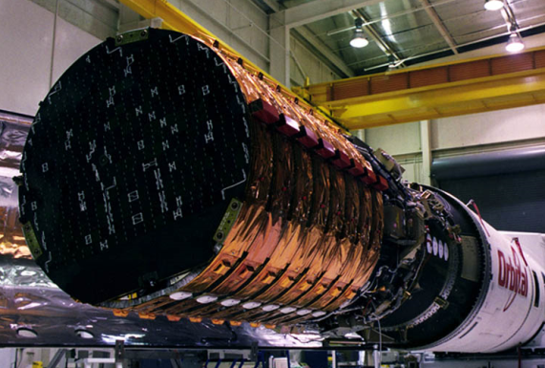
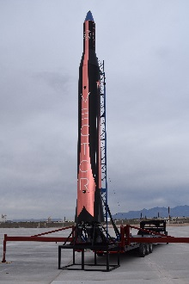
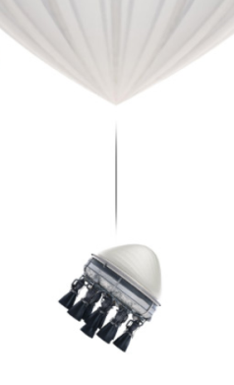

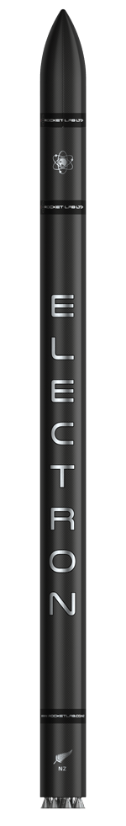
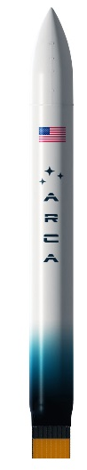
Mini Launchers
Courtesy of Orbital ATK
Vector-R Courtesy of Vector Space
Vector-R is a two-stage all composite pressure fed propylene ground launched vehicle using LOX as an oxidizer with 30 kg capabilities from Vector Space.
Bloostar Courtesy of Zero2Infinity
Bloostar is a three-stage all composite pressure fed liquid cryogenically propelled balloon launched vehicle with toroidal tanks with 75 kg capabilities from Zero2Infinity.
Arion 2 is a three-stage partially reusable liquid fueled launch launched from land with 150 kg capabilities from PLD Space.
Electron Courtesy of Rocket Lab
Electron is a two-stage LOx/kerosene ground launched vehicle using 3D printed engines with electric fuel pumps with 150 kg capabilities from Rocket Lab.
Arion 2 Courtesy of PLD Space
Haas2Ca Courtesy of ARCA
Haas 2C is a single-stage-to-orbit Hydrogen Peroxide/RP fueled launch vehicle utilizing an aerospike engine with 100 kg capabilities from ARCA.

Slide 14
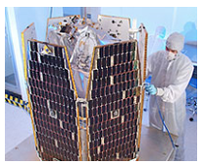
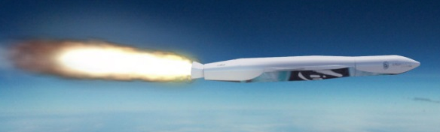
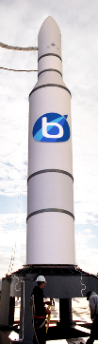
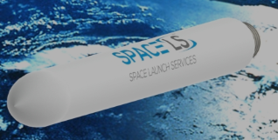

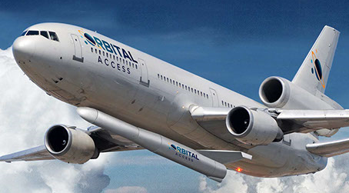
Small Launchers
Courtesy of Orbital ATK
LauncherOne Courtesy of Virgin Galactic
LauncherOne is a two stage RP-1 fueled 747 air launched vehicle with LOx as an oxidizer with 500 kg capabilities from Virgin Orbit.
Volant Courtesy of Alaska Aerospace Corp
Volant is a three-stage solid ground launched vehicle with 215 kg capabilities from bSpace.
Prometheus-1 is a multi-stage kerosene ground launched vehicle with reusable first stage using H2O2 oxidizer with 250 kg capabilities from SpaceLS.
Prometheus-1 Courtesy of SpaceLS
Orbital 500 is an air-launched rocket (likely a DC-10) with 500 kg capabilities from Orbital Access
Tronador II Courtesy of Wikipedia
Tronador II is a ground launched 2.5 stage rocket LOx/RP-1 fueled first stage (sheds two engines) and hydrazine second stage with 250 kg capabilities from CONAE.
Orbital 500 Courtesy of Orbital Access

Slide 15
Trends Since 2015

Slide 16
Since 2015 New Players and Progress …
New Players Include …
ISRO
Cloud IX
Skyora
LEO Launcher
Orbex
And many more
Orbital Launches
Kuaizhou-1
Electron (partial success)
Suborbital Flight Tests
Vector-R
Bloostar
Significant General Press Coverage
Motley Fool
The Economist
Forbes
Kaituozhe-2
Wired
Ars Technica
RocketStar
Pipeline2Space

Slide 17
…And Plenty of Heartbreak as Well
Program Ending Failures
Super Strypi
SS-520-4
Programs Canceled
SALVO
Go Launcher 2
ALASA
Company folded
Garvey Space Corporation (incorporated into Vector)
Swiss Space Sytems
Firefly (back as Firefly Aerospace)
XCOR
SOAR
Spyder
In 2015, 12 of our surveyed vehicles promised a launch by 2017
As of December 2017 only two have flown and attempted orbital launch
(plus two more that were not in 2015 survey)

Slide 18
On the Watch List
Thirty additional vehicles have been identified
Not enough information was available to qualify for our survey
Or their current status is unknown
Organization | Vehicle Name | Country
8 Rivers | Thor | USA
Aerojet Rocketdyne | Hera II | USA
Airbus | Unknown | France
Artemis Space | Unknown | United Kingdom
Avio SpA | VegaC Lite | Italy
B2Space | Colibri | UK
bluShift Aerospace | Unknown | USA
Cloud Aerospace | CloudOne Plus | USA
EXO Corp | EXO | USA
Firefly Aerospace | Firefly Alpha | USA
FORE Dynamics | NFR-1 | USA
Generation Orbit | GOLauncher 2 | USA
Independence-X Aerospace | DNLV | Malaysia
JP Aerospace | Airship to Orbit (ATO) | USA
Launcherspace | Unknown | USA
Leaf Space | Primo | Italy
Nammo | North Star Launch Vehicle | Norway
New Ascent | Unknown | USA
Newton Launch Systems | Unknown | United Kingdom
Odyne Space | Unknown | USA
Onera | Altair | France
Pipeline2Space | Unknown | USA
Rose Galactic | Anthium Orbital Cannon | USA
SMILE | SMILE | Europe
Space Ops | Rocky 1 | Australia
SpinLaunch | Unknown | USA
Swedish Space Corporation | Rainbow Smallsat Express | Sweden
UP Aerospace | Spyder | USA
Vanguard Advanced Systems | Athena | UK
Vogue Aerospace | RESSA | USA/Italy

Slide 19
Summary
SpaceX’s success has created “launch fever”
Small launch vehicles are attempting to capitalize on the expected explosion in small satellite launch requirements
Few current medium/large launch vehicle suppliers are participating in perceived market demand explosion
Please provide corrections, additions, and comments to:
  Carlos.Niederstrasser@orbitalatk.com
  Warren.Frick@orbitalatk.com
What will the 2018 version of the survey hold?

