Slide 1
US SPACEPORT INFRASTRUCTURE: HISTORY IN THE MAKING
A COMPARISON WITH THE EVOLUTION OF US AIRPORT INFRASTRUCTURE
M. Brinkofski and Sarah Hubbard
January 2018
Transportation Research Board Annual Meeting

Slide 2
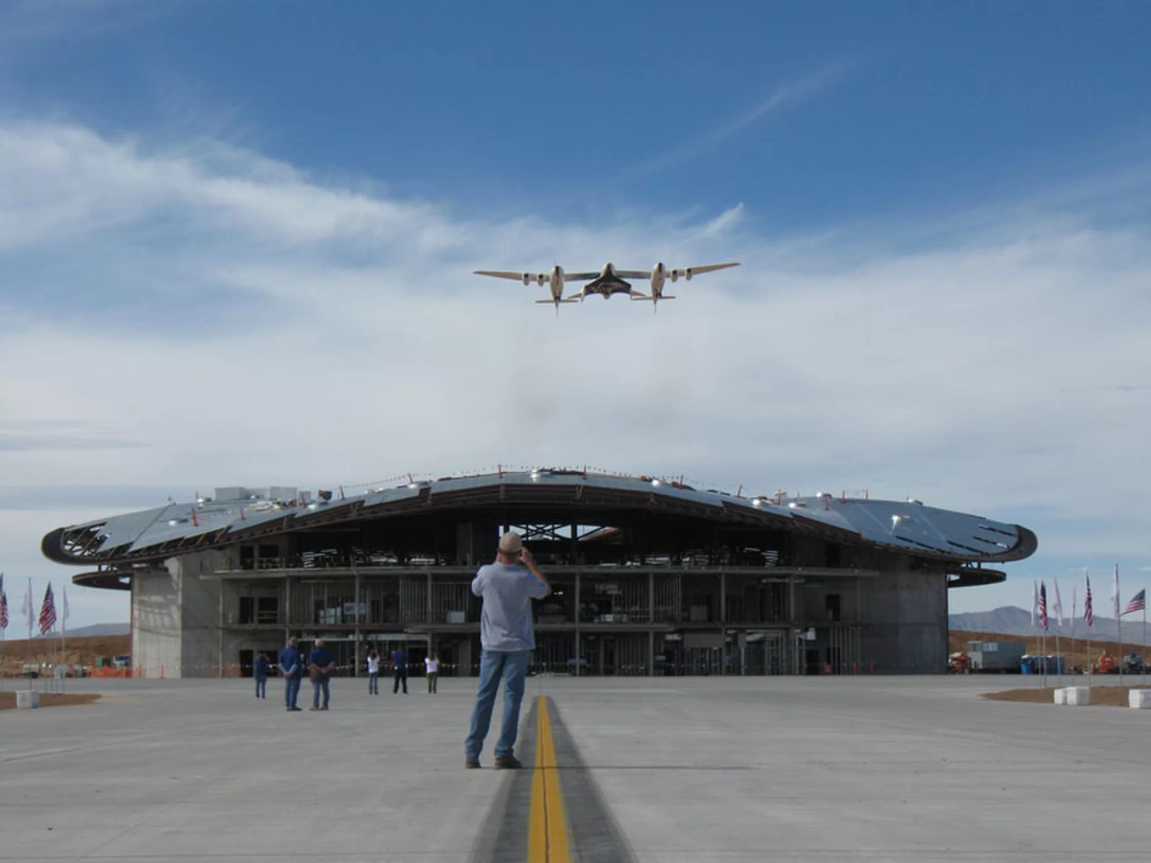
Overview
Virgin Galactic’s SpaceShipTwo over New Mexico’s Spaceport America (suborbital).
Spaceport evolution
Airport evolution
  Regulatory framework for airports
  has evolved over more than a century
Spaceport evolution
  Private industry activities have played an important role in space exploration
  1962: Communications Satellite Act provided federal regulations for public-private monopoly on satellite communications
  1980: Arianespace SA founded as first commercial launch service
  1984: Congress passed the Commercial Space Launch Act (CSLA) which recognized the potential role of the private sector
    Assigned oversight to DOT with AST originally reporting to Secretary of Transportation, later to FAA
Photo: https://www.space.com/9525-spaceport-kicks-high-gear-commercial-spaceflight.html

Slide 3
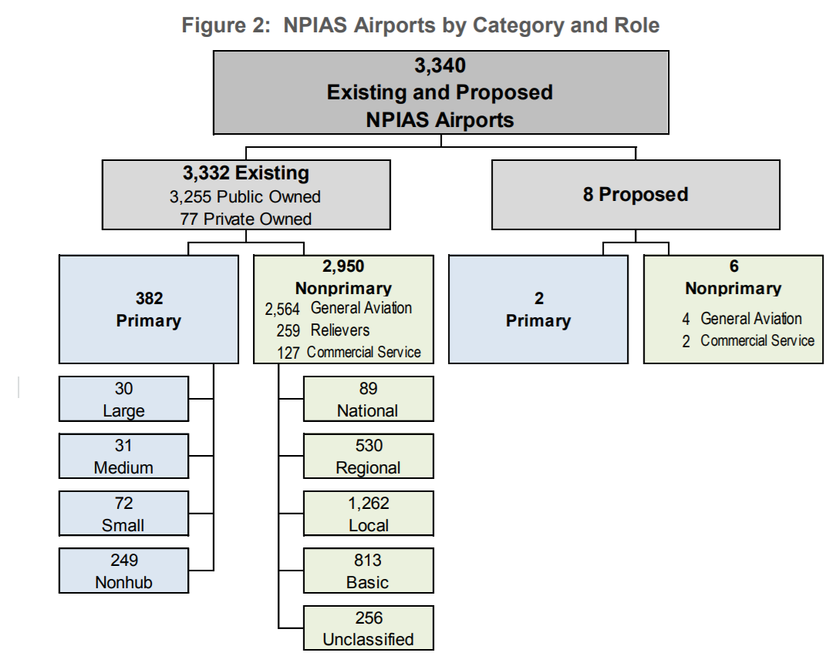
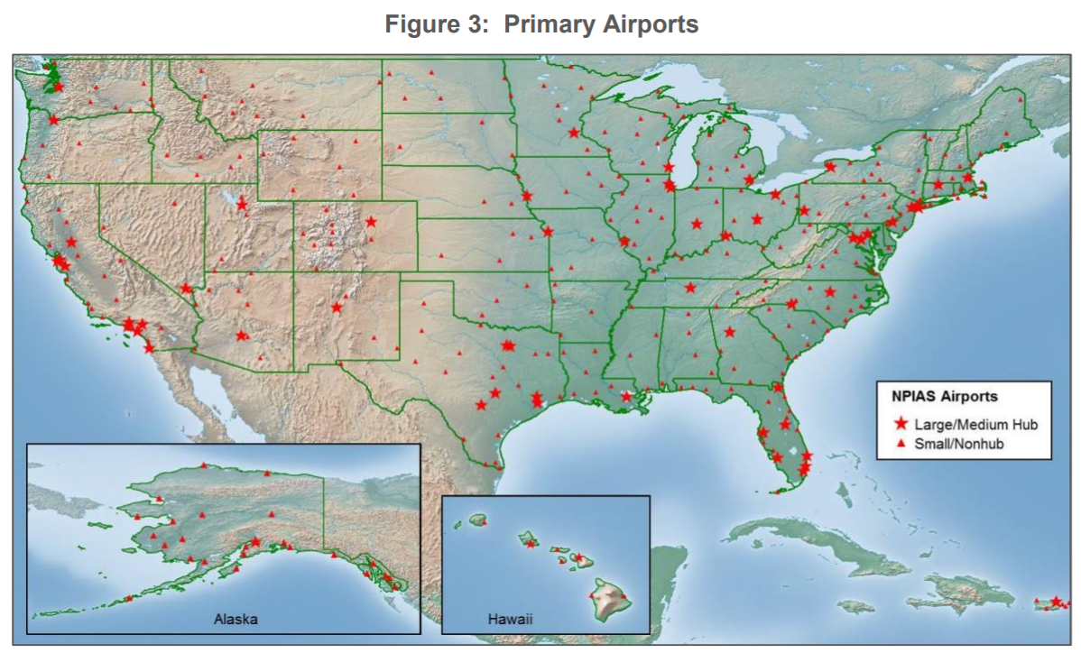
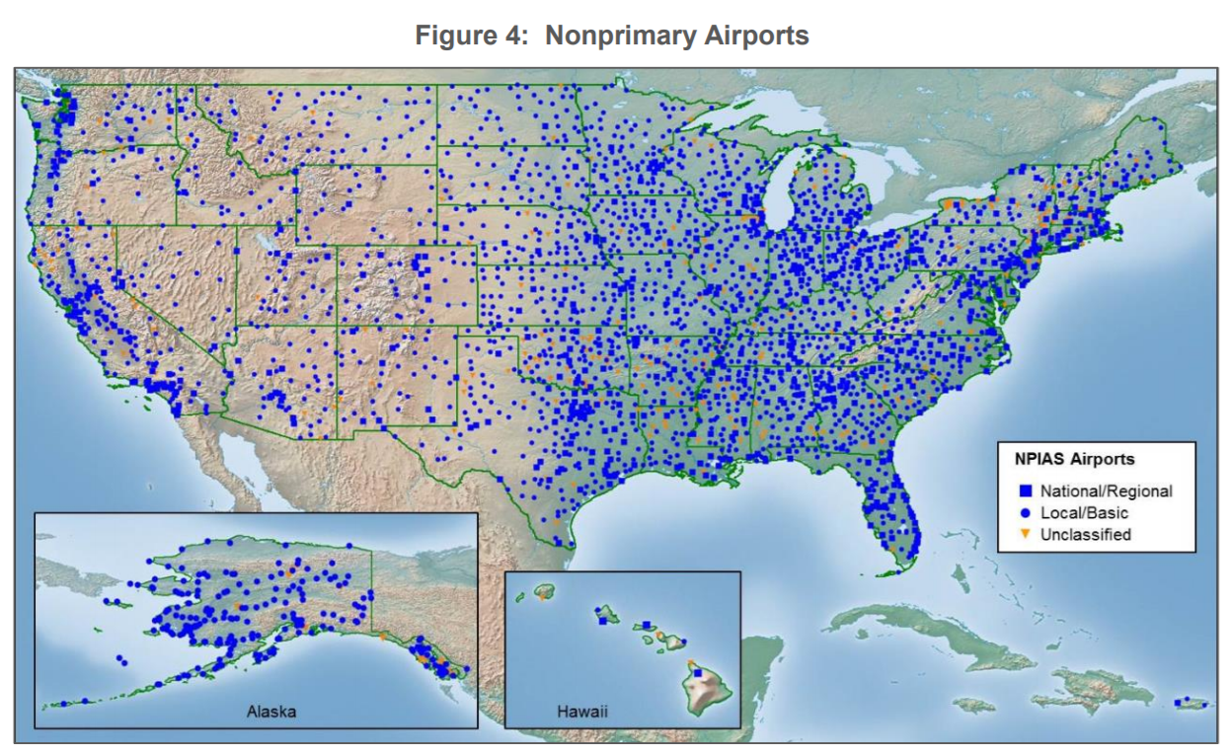
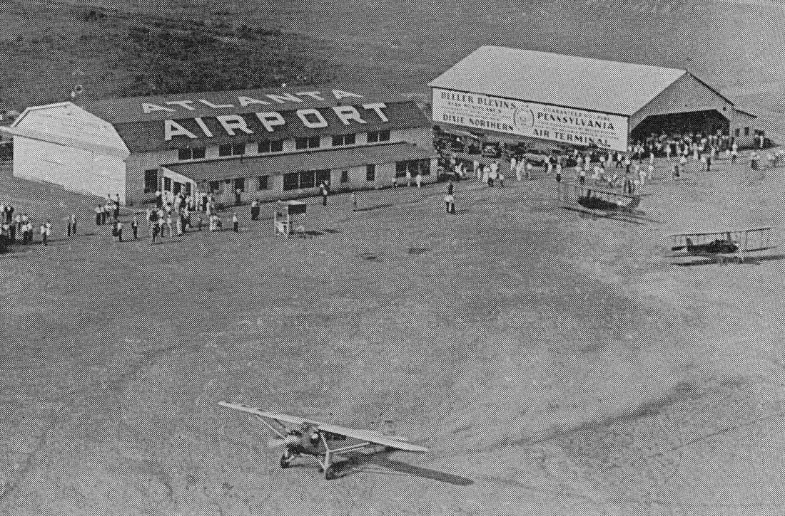
US Airports
http://www.sunshineskies.com/atlanta1920s-1930s.html
https://www.faa.gov/airports/planning_capacity/npias/reports/media/NPIAS-Report-2017-2021-Narrative.pdf
Notes:
A century of progress and the US airport system has evolved from municipally funded airports to a structured national system of thousands of airports across the country.
Currently, FAA licenses airports under Part 139, Airport Certification for airports that serve commercial service
Photo: THE EARLY YEARS OF ATLANTA AIRPORT : 1920s - 1930s
The first scheduled airline service from Atlanta occurred on September 15, 1926 when a Florida Airways plane departed for Jacksonville and Miami. A crowd of 15,000 turned up to witness the historic event. Unfortunately, the airline quietly ceased operations only 9 months later leaving Atlanta and its new airport without airline service. In August 1927, New Orleans-based St. Tammany - Gulf Coast Airways began airline service to Atlanta followed by Pitcairn Aviation in 1928. Pitcairn would eventually become Eastern Air Lines which, along with Delta, dominated Atlanta Airport for more than 6 decades.
Charles Lindbergh visited Atlanta Airport on October 11, 1927 during a cross-country tour following his solo flight across the Atlantic. The aircraft in the foreground is a Ryan B-1 similar to the "Spirit of St. Louis". The actual "Spirit of St. Louis" lacked cockpit and cabin windows due to extra fuel tanks that were installed for the trans-Atlantic flight. During his visit to Atlanta Lindbergh ended up ankle deep in mud after his aircraft became stuck in the wet Georgia red clay.

Slide 4
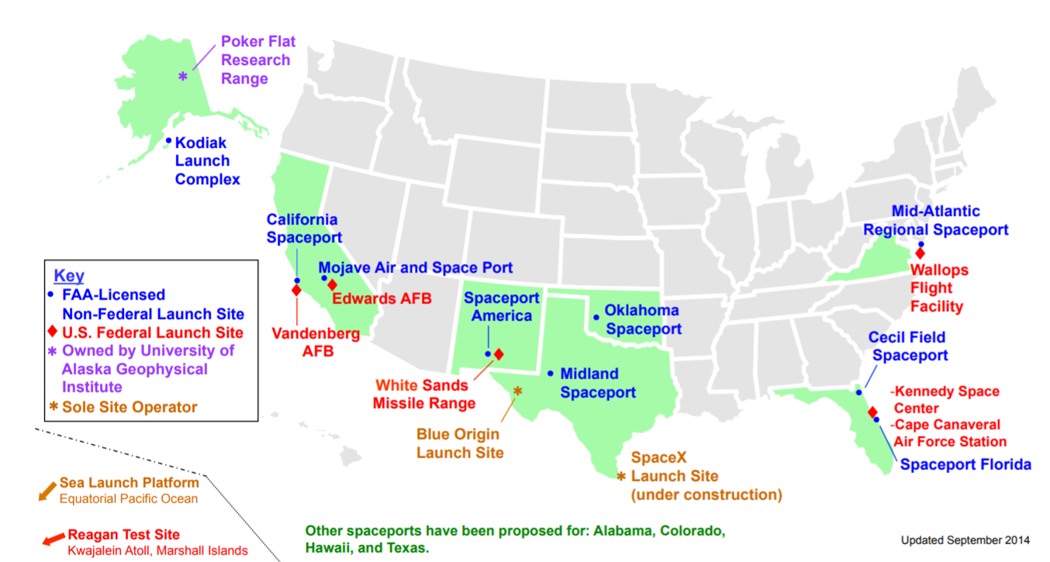
US Spaceports
Commercial/Government/Private Active and Proposed Launch Sites
Image: https://www.faa.gov/about/office_org/headquarters_offices/ast/industry/media/Map_US_spaceports.pdf
Notes:
Not all of these are licensed under CFR Part 420
This discussion focuses on commercial spaceports, rather than private facilities that provide launches for a single company

Slide 5
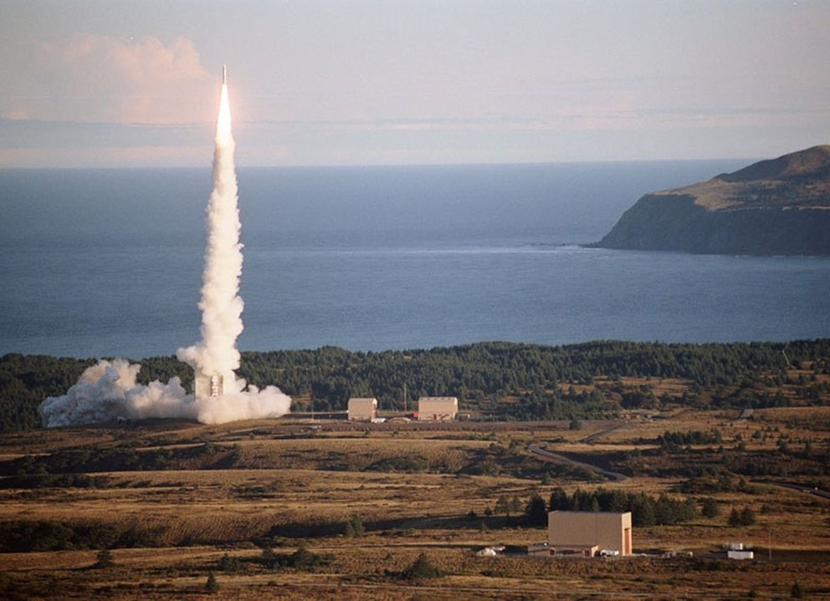
US Commercial Launch Sites
Launch Site | Comments
California Spaceport (1996) | First to be licensed by FAA and became operational in 1999. Collocated with Vandenberg Air Force Base.
Mid-Atlantic Regional Spaceport, (MARS) (1997) | Collocated with NASA’s Wallops Flight Facility. Full service launch facilities for small- and mid-class launch facilities. Serves Orbital ATK for cargo delivery to ISS.
Pacific Spaceport Complex AK (1998) | First commercial spaceport not collocated on a federal range, covers 3,717 acres. Spaceport operator is ACC which is owned by the Alaska Department of Dept. of Military and Veterans Affairs.
Cape Canaveral Spaceport (1999) | Collocated with Cape Canaveral (used by NASA and Air Force from 1962 to 2005) and NASA’s Kennedy Space Center. Most active launch location in the US serving SpaceX, United Launch Alliance (Boeing and Lockheed Martin) and Blue Origin.
Pacific Spaceport Complex-Alaska in Kodiak
https://www.adn.com/business-economy/2016/07/01/
alaska-aerospace-corp-lands-big-federal-contract-for-kodiak-launch-site/
Notes:
We say when you know one airport, you know one airport, because each aiprot is unique. We could say the same thing about commercial launch sites. Each one has unique capabilities and a unique history.
Some evolved from previous federal launch sites, such as Cape Canaveral, which is one of the most active sites and was used by both NASA and the Air Force.
The Mid-Atlantic Regional Spaceport is collocated with NASA’s Wallops Flight Facility, and serves NASA through a contract with Orbital ATK.
Some launch sites are co-located with military facilities, such as the California Spaceport, which is collocated with Vandenberg Air Force Base, and was the first to be licensed by FAA in 1996 and become operational in 1999.
The first commercial spaceport not collocated on a federal range is the Pacific Spaceport Complex in Alaska, which is operated by the Alaska Aerospace Corporation, part of the Alaska Department of Military and Veterans Affairs.

Slide 6
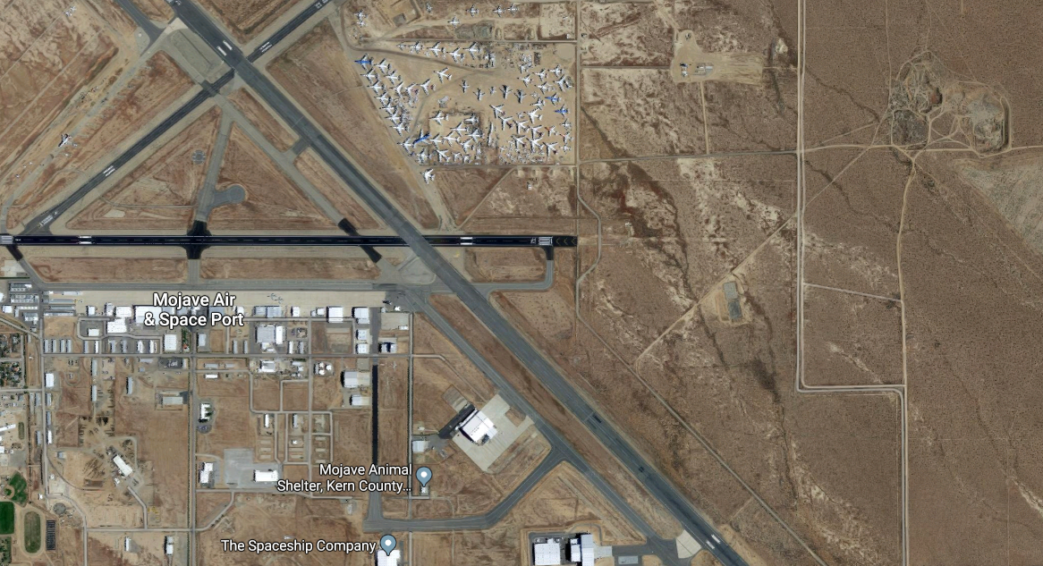
US Commercial Launch Sites
Launch Site | Comments
Mojave Air and Space Port, CA (2004) | First spaceport collocated with a civil airport and first US facility licensed for horizontal launches of reusable spacecraft. Sixty companies have operated out of Mojave (e.g, XCOR, Masten Space Systems, Virgin Galactic, Stratolaunch Systems, Firestar Technologies, Orbital Sciences Corporation).
Oklahoma Spaceport, Burns Flat, OK (2006) | Collocated with airport and industrial airpark at Clinton Sherman (former AFB). FAA approved spaceflight corridor that is not in restricted airspace or Military Operations Areas (MOAs).
Spaceport America, NM (2008) | First purpose built commercial spaceport on 18,000 acres adjacent to the U.S. Army White Sands Missile Range 6,000 square miles of restricted airspace, low population density, a 12,000-foot spaceway.
Mojave Air and Space Port
In California
https://www.google.com/maps/@35.0595225,-118.1548057,3458m/data=!3m1!1e3
Notes:
The Mojave Air and Space Port was the first spaceport collocated with a civil airport in 2004, and the first facility in the US licensed for the horizontal launch of reusable spacecraft. This has been an active spaceport, serving more than sixty companies, one of which was Scaled Composites, with SpaceShipOne,,the first privately funded human sub-orbital flight in 2004 and the winner of the $10M Ansari X prize. Sadly this was also the site of the fatality with SpaceShipTwo following the launch in 2014.
The Oklahoma Spaceport is also state supported and collocated with an airport and industrial park at the former Air Force Base (Clinton Sherman). Intended for space tourism, R&D, military and civilian uses, this spaceport has a spaceflight corridor free of restricted airspace and Military Operations Areas, but has not yet been sued for a launch.
Spaceport America is a well-known icon and was the first purpose built commercial spaceport with a 12,000 ft spaceway next to the White Sands Missile Range. Primarily funded by the New Mexico taxpayers, there has been some activity but it has not yet lived up to the expectations.

Slide 7
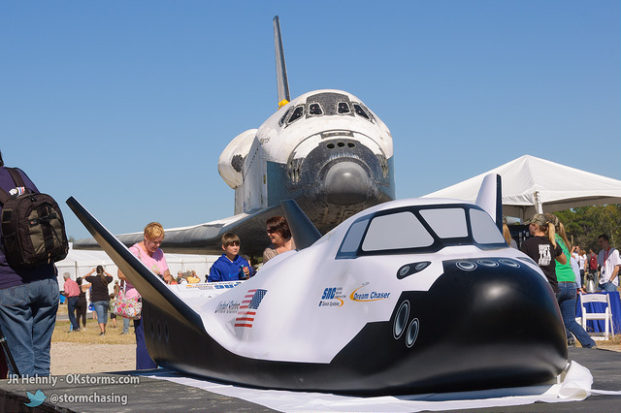
US Commercial Launch Sites (cont)
Launch Site | Comments
Cecil Field Spaceport, FL (2010) | Collocated on 150 acres adjacent to Cecil Airport, a joint-use civil and military airport. Only licensed horizontal launch and recovery site for commercial spaceport on the East Coast (12,500 ft long runway 18L-36R).
Midland International Air and Space Port, TX (2014) | Collocated on 1600 acres with Midland Intl Airport and Sloan Field XCOR Aerospace, Orbital Outfitters in vicinity. First facility licensed to serve both commercial airline flights and commercial human spaceflight.
Ellington Field, TX (2015) | FAA has approved first urban spaceport application. Interested partners sought for spaceport development, collocated with Ellington Airport, a civil and military use airport. Johnson Space Center and over 80 aerospace companies in Houston.
Midland Intl Air & Space Port
In Texas
is certified for the Dream Chaser I
http://spaceflights.news/?p=48751
Notes:
Cecil Field is collocated with Cecil Airport, a joint-use civilian and military airport, and is the only site licensed for both horizontal launch and recovery on the east coast.
Midland is also collocated with an airport, and is licensed to serve commercial human spaceflight as well as airline flights. Midland is also near multiple private launch sites.
Ellington Field in Houston is part of the Houston Airport System. The FAA has approved the application, and the City Council has allocated almost $7M for development, to support the estimated cost which will potentially exceed $120M, which will hopefully be funded by a partnership.
Clearly the

Slide 8
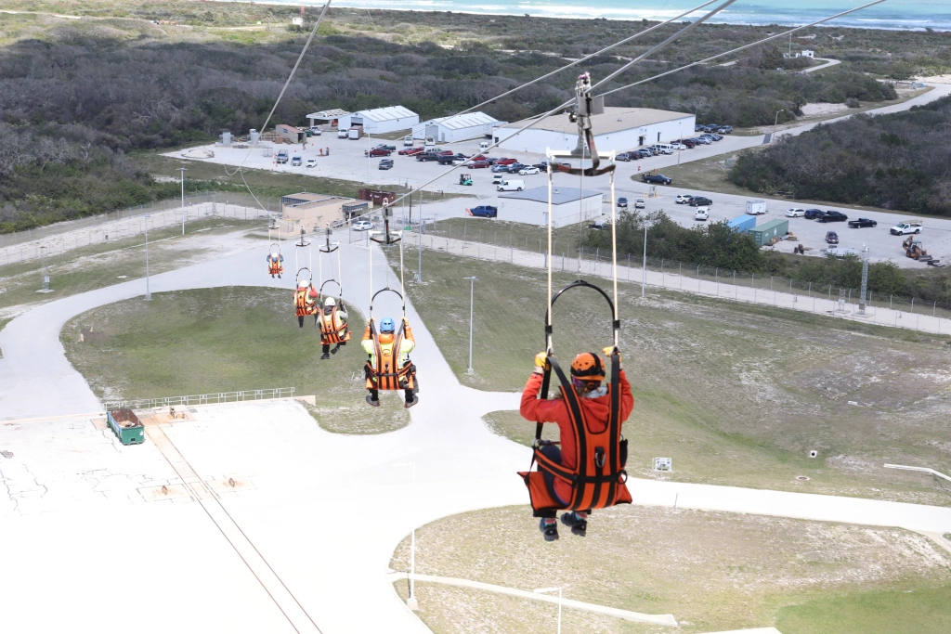
Spaceport Body of Knowledge
As identified by FAA
Airfield and launch operations,
Site security,
Emergency response,
Visitor management,
Ground and flight safety,
Environmental management,
Mission readiness,
International Traffic in Arms Regulations (ITAR)
  Address export and import of
  defense related activities and technologies,
International coordination,
Self-inspection.
May not reflect all components: Airspace Standards
Boeing and ULA demo Emergency Egress System for crewed space launches
Demonstration from
Crew Access Tower at Pad 41.
Photo: https://techcrunch.com/2017/04/03/boeing-and-ula-demo-their-emergency-egress-system-for-crewed-space-launches/
Notes:
This list may not be complete. It does not include spaceport’s airspace standards which is obviously critical for safe launches.
This

Slide 9
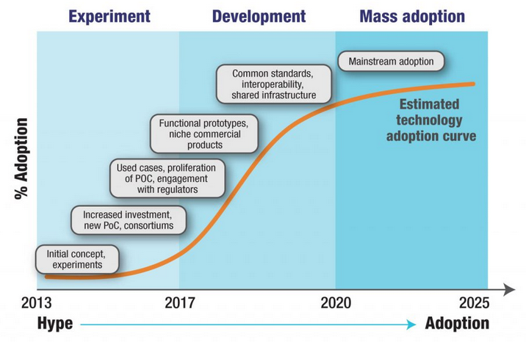
Spaceport Body of Knowledge
As identified by FAA
Goal: Launch site interoperability
Lays foundation for future standards for spaceports
Analogous to standards and interoperability for
airport infrastructure as defined by:
FAA regulations in 14 CFR Part 139 Airport Certification
ICAO Annex 14, Aerodromes.
Image: https://www.nextbigfuture.com/2017/08/3u-cubesat-launch-will-be-months-instead-of-years-and-only-250000-starting-in-2019.html from Asian Banker Research.
Notes:
Image references financial market but similar concept wrt interoperability for commercial space launches

Slide 10

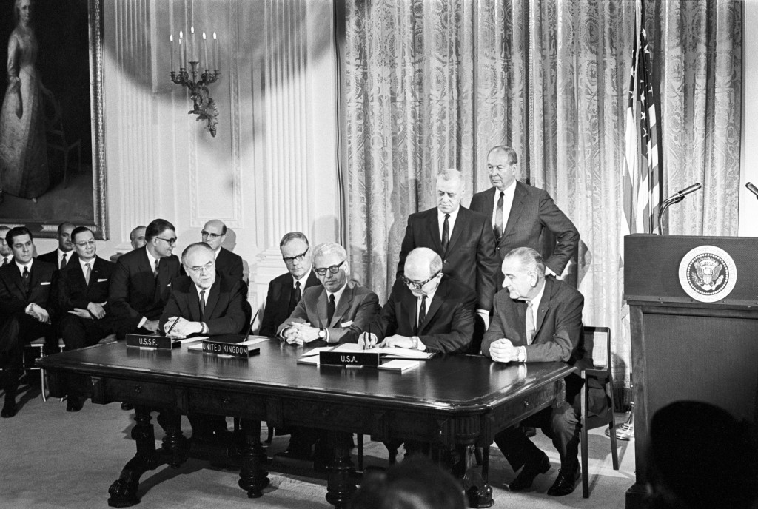
Legislation and Regulations
for Aviation and Commercial Space Activities
 | Aviation | Commercial Space
International Governance | 1944: Convention on International Civil Aviation signed (entered into force in 1947) creating ICAO. Support international aviation safety for the current 191 member states. | 1967: Treaty Governing the Activities of States in the Exploration and Use of Outer Space including the Moon and Other Celestial Bodies drafted by the UN Committee on Peaceful Uses of Outer Space. Obligates US and the over 100 other signatory states to broad principles.
Photo: http://sciencevibe.com/2015/10/21/the-treaty-that-forbids-weapons-of-mass-destruction-in-outer-space/
http://www.eurocontrol.int/events/icao-air-transport-symposium

Slide 11
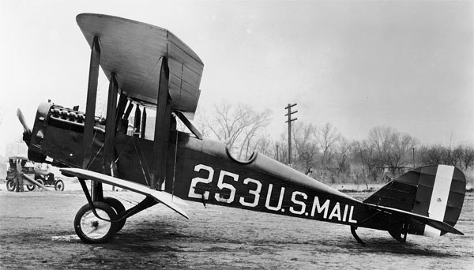
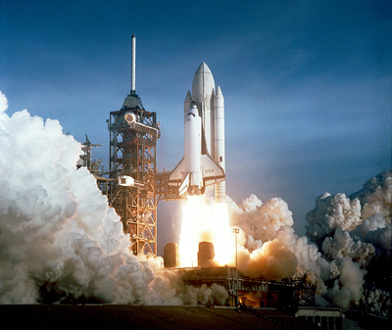
Legislation and Regulations
for Aviation and Commercial Space Activities
 | Aviation | Commercial Space
Legislation Enabling Commercial Activities | 1925: Air Mail Act allowed federal government to contract with air carriers for mail transport, represents start of commercial aviation. | 1984: Commercial Space Launch Act (CSLA) encourages promotion of commercial space activities and federal regulation of operators, launches, and reentries.
Legislation for Pilot and Aircraft Licensing | 1926: Air Commerce Act established pilot and aircraft licensing through FAA. | CSLA established federal oversight through AST including permitting and licensing of vehicles, launch and reentry sites, and operating techniques Moratorium for regulation of human participants through 2023.
Airport and Spaceport Licensure | 1970: Airport and Airways Development Act and Revenue Act established FAR Part 139, Airport Certification for commercial airports. | CSLA authorizes federal regulation of commercial launch sites through Part 420, License to Operate a Launch Site.
Photo: http://www.antiqueairfield.com/features/us_airmail.html, http://www.texasgopvote.com/government/senate-approves-us-commercial-space-launch-competitiveness-act-008044

Slide 12
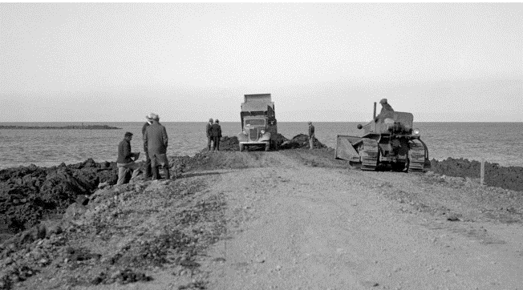
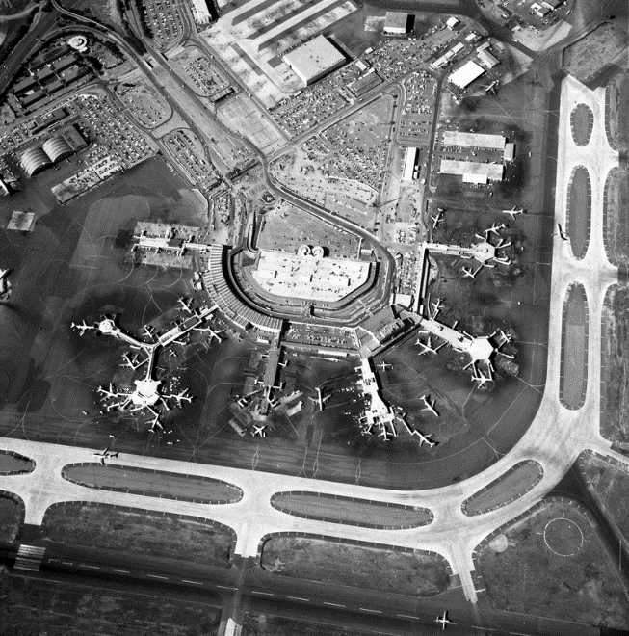
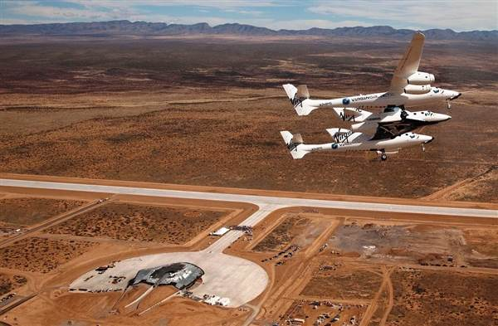
Legislation and Regulations
for Aviation and Commercial Space Activities
 | Aviation | Commercial Space
Funding for Airport/ Spaceports | There was no federal funding for airports per Air Commerce Act of 1926. Federal Airport Act of 1946 provided federal funding for airports essential to the US (predecessor to current Airport Improvement Plan, AIP). Airport and Airways Development Act and Revenue Act of 1970 established an aviation trust fund for airport planning and development. | There is no ongoing and dedicated source of federal funds for spaceports although federal funding for selected spaceports was provided via grants such as the FAA AST Space Transportation Grants Program, which provided up to 50% of project funds and an appropriation limit of $10M⁴. Although funds were budgeted in 2010, 2011 and 2012, in subsequent years a lack of dedicated funds for this program resulted in a lack of grants.
1935: Airfield expansion at SFO after voters approve $260,000 in local funding
1970: SFO
2010: Virgin Galactic SpaceShipTwo and WhiteKnightTwo over Spaceport America
https://www.flysfo.com/about-sfo/history-sfo, https://www.yesterdaysairlines.com/san-francisco---1959-1978.html
https://www.nbcnews.com/storyline/virgin-voyage/new-mexicos-spaceport-america-takes-shape-middle-nowhere-n87166
Notes:
1935: SFO airfield expansion, 1933, SF voters approve $260k in airport development funds
1970 view of SFO

Slide 13
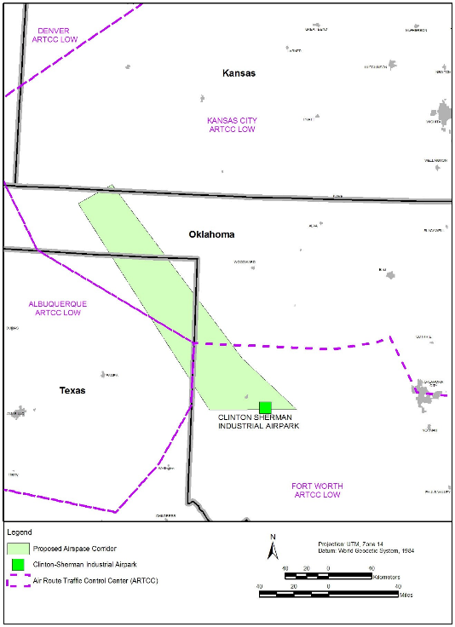
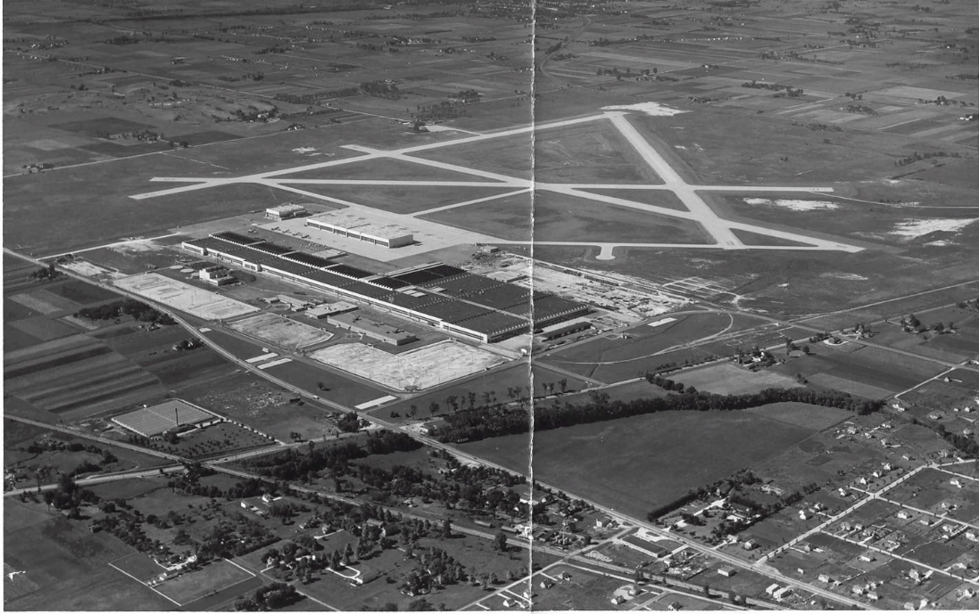
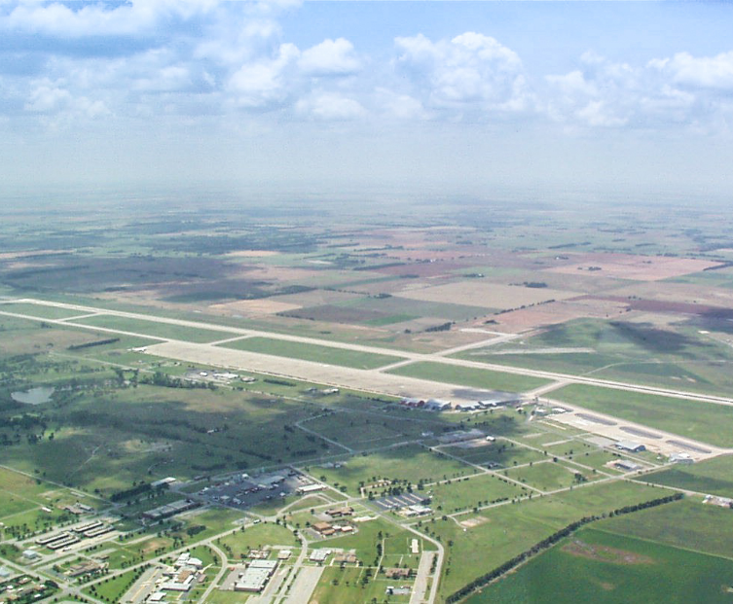
Legislation and Regulations
for Aviation and Commercial Space Activites
 | Aviation | Commercial Space
Facility Planning | Federal Airport Act of 1946 required development of a National Airport Plan, a predecessor to the current NPIAS. The Airport and Airways Development Act and Revenue Act of 1970 created a Planning Grant Program (PGP) to provide funds for airport master plans and airport system plans. Federal funds for planning have expanded and are funded through the AIP program. | There is currently no federal spaceport system plan nor are there funding programs specifically for facility planning. Individual spaceports or states may develop spaceport plans, and spaceport facilities operations must be integrated into airport master plans when facilities are collocated.
Facility Inventory | Chart Supplements are compiled and kept current by FAA based on Airport Master Record 5010 forms submitted by airports certified under part 139. | Operations Working group of COMSTAC has suggested the creation of an FAA AST spaceport directory to provide information about the launch capabilities of each licensed spaceport.
Oklahoma Air and Space Port and Infinity One Spaceflight Corridor
Douglas Aircraft Plant where ORD now stands
Photo: http://www.cirrusimage.com/ORD.htm, https://airspaceportok.com/wp-content/uploads/2015/01/Air-Corridor-NW.jpg
Notes:
Oklahoma spaceflight corridor is 152-mile-long and 50-mile-wide

Slide 14
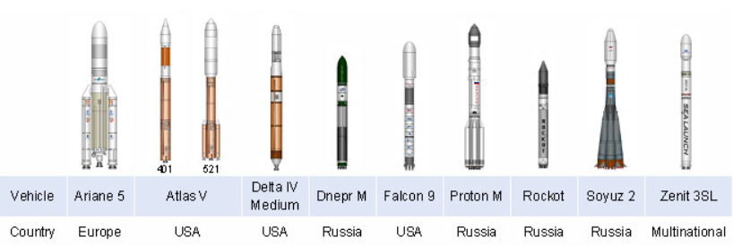
Special topics: Collocation of Spaceports and Airports
Design and standards.
  Launch vehicles do not currently fall within any designated aircraft design categories.
  Implications for airfield design (including operational and policy considerations).
Safety and operations for compatibility of spaceport and airport operations.
Airport planning challenges: forecast activities and reciprocal impact of commercial space and aviation activities.
Environmental considerations: include federal, state and local environmental laws and compliance with National Environmental Policy Act (NEPA).
  AST is the lead office for environmental review.
  Special consideration to noise since spaceport operations may have different noise sources (aircraft, RLVs, ELVs) and characteristics not addressed by current FAA noise modeling procedures.
Funding: Airport funding through AIP, AIP Handbook does not include explicit authorization for launch site funding.
Launch Vehicles
https://integratedspaceanalytics.com/cms/content/active-launch-vehicles

Slide 15

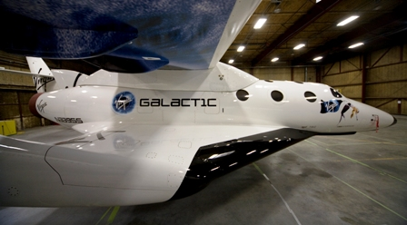
Future considerations and Discussion points
Best framework for agency oversight at federal level?
What are the industry needs? What agency or entity can best meet these needs?
Proposed launch sites .
  Nine more proposed in US including Colorado, Hawaii, Arizona, and Georgia
  Six international including UK, New Zealand, AbuDhabi, Malaysia and Caribbean.
  Will demand justify the proposed capacity?
    Horizontal reusable launch vehicle operators will spur demand.
    Horizontal reusable launch is more compatible with airports.
Exclusive use sites for specific vehicles and operators do not require Part 420 license.
  Examples: Blue Origin, SpaceX, United Launch.
Spaceport Abu Dhabi will have exclusive regional rights for Virgin Galactic’s SpaceShip-Two
http://www.timeoutabudhabi.com/knowledge/news/78481-abu-dhabi-named-worlds-safest-city http://www.slate.com/articles/technology/future_tense/2017/03/why_the_united_arab_emirates_is_building_a_space_program.html

Slide 16
Selected References
Marconi, Elaine M. (2006, March 9). Robert Goddard: A Man and His Rocket. Retrieved from http://www.nasa.gov/missions/research/f_goddard.html
Coleman, K., & Nield, G. (2013). Industry Standards for Commercial Space Transportation. Retrieved from ttps://www.faa.gov/about/office_org/headquarters_offices/ast/programs/international_affairs/media/Industry_Standards_paper_IAC_Sept_2013_FAAfinal.pdf
National Aeronautics and Space Administration (n.d.). Emerging Space: The Evolving Landscape of 21st Century American Spaceflight. Retrieved from https://www.nasa.gov/sites/default/files/files/Emerging_Space_Report.pdf
Dillow, Clay (2016, February 22). VCs Invested More in Space Startups Last Year than in the Previous 15 Years Combined. Fortune. Retrieved from http://fortune.com/2016/02/22/vcs-invested-more-in-space-startups-last-year/
Holdren, John P. (2016, April 4). Report on on-orbit authority, as required by the Commercial Space Launch Competitiveness Act (Public Law 114-90). Retrieved from https://www.whitehouse.gov/sites/default/files/microsites/ostp/csla_report_4-4-16_final.pdf
Space Florida (2013). Florida Spaceport System Plan 2013. Retrieved from http://www.spaceflorida.gov/docs/spaceport-ops/florida-spaceport-systems-plan-2013_final.pdf?sfvrsn=2
Noffz, G. K, (2017, June 26-29) NASA Flight Opportunities Program, Presentation at Commercial and Government Responsive Access to Space Technology Exchange (CRASTE), Indian Wells, CA.
Wall, M. (2016, October 05). Jeff Bezos' Blue Origin Space Capsule Aces Dramatic In-Flight Escape Test. Space.com. Retrieved from https://www.space.com/34302-blue-origin-space-capsule-escape-test.html Rosen, Ben (2016, June 20) Will Bezo’s Blue Origin be the Birst Company to send Tourists to Space? The Christian Science Monitor. http://www.csmonitor.com/Science/Science-Notebook/2016/0620/Will-Bezos-s-Blue-Origin-be-the-first-company-to-send-tourists-to-space
Federal Aviation Administration (2017, January). The Annual Compendium of Commercial Space Transportation: 2017. Retrieved from https://www.faa.gov/about/office_org/headquarters_offices/ast/media/2017_AST_Compendium.pdf
Whalen, D. J. (2010, November 30). Communications Satellites: Making the Global Village Possible. Retrieved from http://history.nasa.gov/printFriendly/satcomhistory.html
Lal, B. (2013). A brief history of government policies to promote commercial space 1. Washington Academy of Sciences. Journal of the Washington Academy of Sciences, 99(3), 25-41. Retrieved from http://search.proquest.com.ezproxy.libproxy.db.erau.edu/docview/1737980165?accountid=27203
The Space Race. (n.d.) History.com Retrieved from http://www.history.com/topics/space-race
Jaeger, R. W., & Claudon, J. L. (1986). Ariane-The first commercial space transportation system. In 15th International Symposium on Space Technology and Science (Vol. 1, pp. 1431-1438).
PanAmSat Corporation (n.d.). Company-Histories.com. http://www.company-histories.com/PanAmSat-Corporation-Company-History.html
Federal Aviation Administration. (2013). About the Office. Retrieved from http://www.faa.gov/about/office_org/headquarters_offices/ast/about/faq/#cl5
Chang, Y. (2015). The first decade of commercial space tourism. Acta Astronautica, 108, 79-91. doi: 10.1016/j.actaastro.2014.12.004
Federal Aviation Administration. (2016). The Annual Compendium of Commercial Space Transportation: 2016. Retrieved from http://www.faa.gov/about/office_org/headquarters_offices/ast/media/2016_Compendium.pdf
Grantham, K. (2013, May 22). Successful Launch Kicks off SpaceX's Historic Mission. Retrieved from http://www.spacex.com/press/2012/12/19/successful-launch-kicks-spacexs-historic-mission
The Tauri Group (2016, January). Start-Up Space, Rising Investment in Commercial Space Ventures. Retrieved from http://space.taurigroup.com/reports/Start_Up_Space.pdf

Slide 17
Selected References
Bontrager, M., Ketcham, D., Kobrick, R., Luney, P., McCarthy, P., & Szabo, S. (2014, November 06). Necessary Conditions and Infrastructure for a Successful Multi-User Spaceport. In Space Traffic Management Conference. Retrieved from http://commons.erau.edu/cgi/viewcontent.cgi?article=1047&context=stm
Gulliver, B. (2016). Commercial Spaceports: Where We Are and Where We Are Going. International Conference on Transportation and Development 2016.
Dillingham, Gerald L. (2016, June 22). Commercial Space Industry Developments and FAA Challenges. Testimony before the Subcommittee on Aviation, Committee on Transportation and Infrastructure, House of Representatives. US Government Accountability Office GAO-16-765T.
Wall, M. (2013, January 16). Space Shuttle Columbia Launched on Tragic Mission 10 Years Ago. Space.com. Retrieved from http://www.space.com/19283-shuttle-columbia-tragedy-launch-10-years.html
Alaska Aerospace. (2014). State Spaceports Receive Federal Funding. Retrieved from http://akaerospace.com/news/state-spaceports-receive-federal-funding
Spaceport Systems International (SSI) (1999). Facilities Overview. Retrieved from ttp://www.calspace.com/Home/Facilities_Overview.html
Dean, James (2016a, February 9). Blue Origin Readying to Build Rockets on the Space Coast. Florida Today. Retrieved from http://www.floridatoday.com/story/tech/science/space/2016/02/09/blue-origin-ready-build-space-coast/79699818/
Mojave Air and Space Port (n.d.), History and Breakthroughs. Retrieved from http://www.mojaveairport.com/history.html
Ogle, Kelly (Feb 1, 2015). We Paid For It: Oklahoma’s Space Initiative. Retrieved from http://www.news9.com/story/27990255/we-paid-for-it-oklahomas-space-initiative
Werley, Jensen (2015, Dec 14). Exclusive: Detailed Plans Plot Cecil Spaceport’s Path to Move Jacksonville into the Space Race. Jacksonville Business Journal. Retrieved from http://www.bizjournals.com/jacksonville/news/2015/12/14/exclusive-detailed-plans-plot-cecil-spaceports.html
Piggott, J. (2014, October 29). Cecil Spaceport prepares for 2016 launch. News 4 Jax. Retrieved from http://www.news4jax.com/news/local/cecil-spaceport-prepares-for-2016-launch
Spaceflight Scheduling (2014, September 22) Aviation Week & Space Technology, p. 16.
Howes, Trevor (2016, June 4). Despite XCOR setback, space industry in Midland continues to grow. Midland Reporter-Telegram. Retrieved from http://www.mrt.com/business/article_465e065c-2ad7-11e6-b0a9-77e58198f7d3.html
Houston Spaceport, (n.d.) Retrieved from http://www.fly2houstonspaceport.com/spaceport/
Wray, Dianna (2015, July 3). Ellington Field is Now an Official Spaceport. Why That’s No Big Deal. Retrieved from http://www.houstonpress.com/news/ellington-field-is-now-an-official-spaceport-why-thats-no-big-deal-7559289
United States, Government Accountability Office. (2016). Commercial Space Launch Insurance. Washington, D.C
Raymond, J. (1997). Airports and Spaceports A Historical Comparison (Unpublished master's thesis). Air Command and Staff College.
Federation of American Scientists (n.d.). DoD Space: An Executive Overview. Retrieved from http://fas.org/spp/military/program/sp97/accomplish.html
Howell, Elizabeth (2016, March 21). Spaceport America: Space Tourism Launch Site. Space.com. Retrieved from http://www.space.com/19258-spaceport-america.html
Handberg, R. (2002). Creating transportation infrastructure though state spaceport initiatives: Florida and other examples. Technology in Society, 24(3), 225-241. doi: 10.1016/S0160-791X(02)00006-4
United States House of Representatives Committee on Transportation and Infrastructure, Subcommittee on Aviation. (2016, June 17). Summary of Subject Matter regarding Subcommittee Hearing on FAA Oversight of Commercial Space Transportation, Retrieved from http://transportation.house.gov/uploadedfiles/2014-06-18-aviation_ssm.pdf

Slide 18
Selected References
Nica, M., Reddy, M. V., & Wilkes, K. (2012). Space tourism: Research recommendations for the future of the industry and perspectives of potential participants. Tourism Management, 33(5), 1093-1102. doi: 10.1016/j.tourman.2011.11.026
New Mexico State University. (n.d.). Body of Knowledge for Spaceport Operations. Retrieved from http://contentdm.nmsu.edu/cdm/landingpage/collection/NMSGCBOK
United States. (1984). Commercial Space Launch Act. Washington, D.C.: U.S. G.P.O. Retrieved from https://www.govtrack.us/congress/bills/98/hr3942/text
College Park Airport. (2014). Retrieved from http://collegeparkairport.aero/
Prather, Daniel C. (2015). Airport Management. Aviation Supplies & Academics, Inc. 2015.
Baltazar, L. (n.d.). Airmail Comes of Age (Federal Aviation Administration). Retrieved from https://www.faa.gov/about/history/milestones/media/Airmail_Comes_of_Age.pdf
Connecticut Statewide Airport System Plan. (2006). Funding. Retrieved from http://www.ct.gov/dot/lib/dot/documents/ddotinfo/Chapter_5_Funding.pdf
Federal Aviation Administration. (2007). National Plan of Integrated Airport Systems (NPIAS). Retrieved from https://www.faa.gov/airports/planning_capacity/npias/reports/historical/media/2009/npias_2009_narrative.pdf
Federal Aviation Administration. (2015). Space Transportation Infrastructure Matching (STIM) Grants Program. Retrieved from https://www.faa.gov/about/office_org/headquarters_offices/ast/programs/stim_grants/
Jacksonville Aviation Authority (JAA). (2012, March). Cecil Spaceport Master Plan. Retrieved from http://www.flyjacksonville.com/Cecil/Spaceport/spaceport-mp.pdf
Graham, D. (n.d.). Federal Aviation Administration (FAA) Space Transportation Infrastructure Matching (STIM) Grants Program. Retrieved from https://www.faa.gov/about/office_org/headquarters_offices/ast/programs/stim_grants/
Federal Aviation Administration (n.d.). FAA STIM Grants Program. Retrieved from https://www.faa.gov/about/office_org/headquarters_offices/ast/programs/stim_grants/
McCarthy, Kevin. United States Congress. Senate. (2015). U.S. Commercial Space Launch Competitiveness Act of 2015: Report of the Committee on Commerce, Science and Transportation on S. 1297. Retrieved from https://www.congress.gov/bill/114th-congress/house-bill/2262/text
Bergin, Chris (2014, December 8). Return to Wallops: New Antares Set for Late 2015 Hot Fire. NASA Spaceflight.com. Retrieved from https://www.nasaspaceflight.com/2014/12/return-wallops-antares-2015-hot-fire/.
Frosch, D. (2014, December 09). Spaceport Woes Bedevil New Mexico. The Wall Street Journal. Retrieved from http://www.wsj.com/articles/spaceport-america-woes-bedevil-new-mexico-1418167988
The U.S. Commercial Suborbital Industry: A Space Renaissance in the Making. (2012). Journal of Magnetohydrodynamics and Plasma Research, 17(3), 207-242. Retrieved from http://search.proquest.com.ezproxy.libproxy.db.erau.edu/docview/1732935124?accountid=27203
Federal Aviation Administration. (2014). Proposed Commercial Space Facilities and Operations at Federally-obligated or Part 139 Airports. Retrieved from https://www.faa.gov/airports/media/ARP-interim-Spaceport-Guidance.pdf
Federal Aviation Administration. (2014). Airport Improvement Program Handbook. Retrieved from http://www.faa.gov/airports/aip/aip_handbook/media/AIP-Handbook-Order-5100-38D.pdf

Slide 19
Conclusion
Aspects of establishing a successful corporate aviation department
Thank you
Comments and Questions
Sarah Hubbard
sarahh@purdue.edu

Slide 20
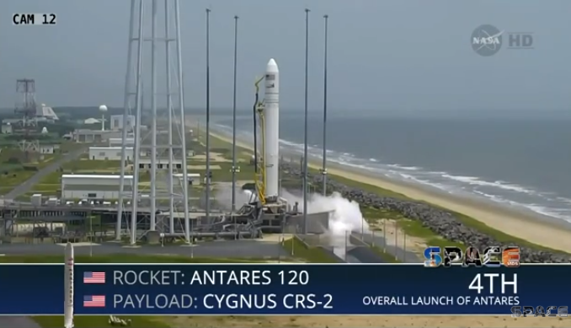
US Commercial Launch Sites
Operator | Spaceport | Location
New Mexico Spaceflight Authority | Spaceport America | Truth or Consequences, NM
Mojave Air & Space Port | Mojave Air and Space Port | Mojave, CA
Virginia Commercial Space Flight Authority | Mid-Atlantic Regional Spaceport | Wallops Flight Facility, VA
Jacksonville Aviation Authority | Cecil Field | Jacksonville, FL
Oklahoma Space Industry Development Authority | Oklahoma Air and Space Port | Burns Flat, OK
Houston Airport System | Ellington Airport | Houston, TX
Space Florida | Cape Canaveral Air Force Station | Kennedy Space Center, FL
Midland International Airport | Midland Intl Air and Space Port | Midland, TX
Harris Corporation | California Spaceport | Vandenberg Air Force Base, CA
Alaska Aerospace | Pacific Spaceport Complex | Kodiak Island, AK
http://www.vaspace.org/index.php/media-center/launch-videos
Mid-Atlantic Regional Spaceport
In Virginia
Antares Orb-2 Resupply Mission to ISS
July 13, 2014
http://www.vaspace.org/index.php/media-center/launch-videos

