Slide 1
Forecasting the Effect of Space Launches on the NAS
Dean Fulmer
The MITRE Corporation
16 January, 2019

Slide 2
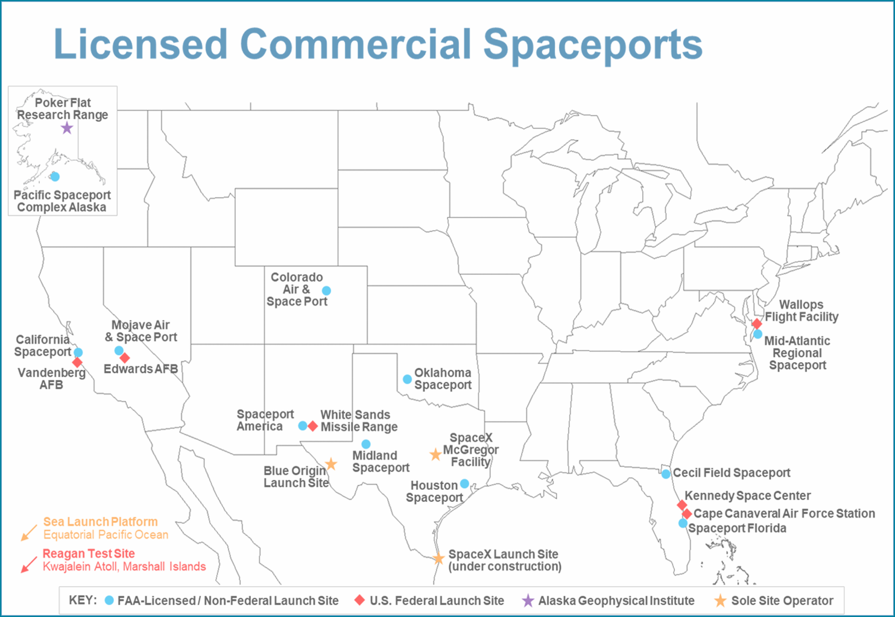
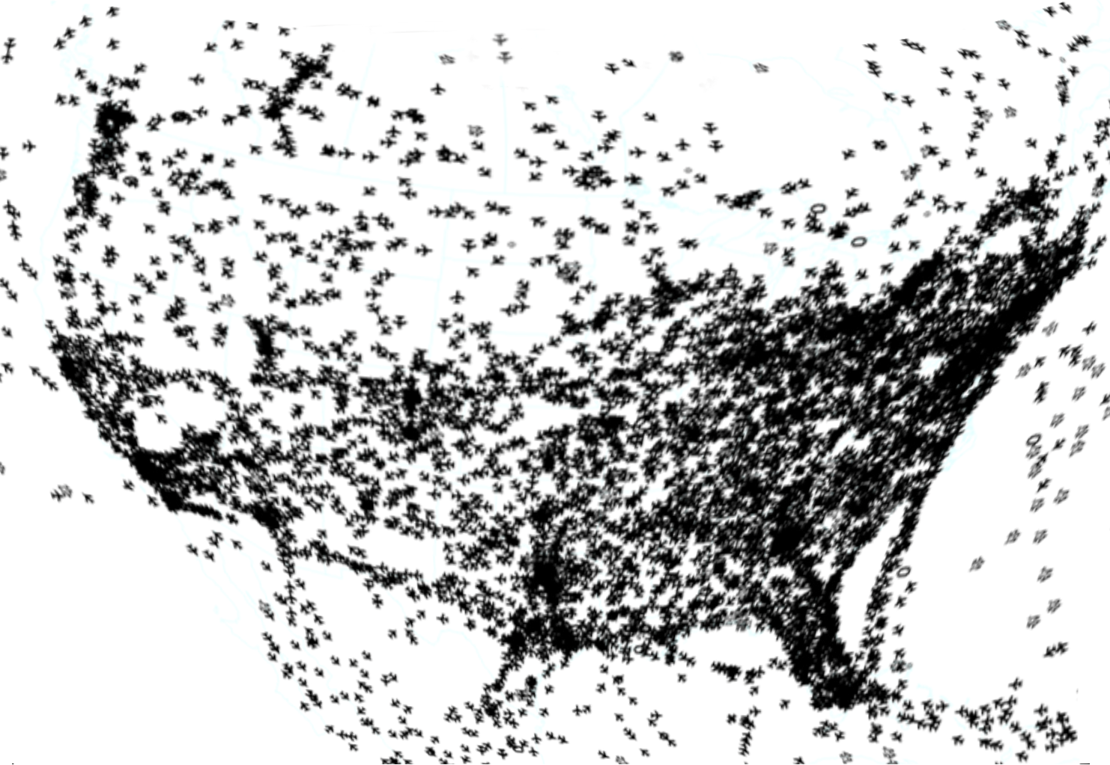
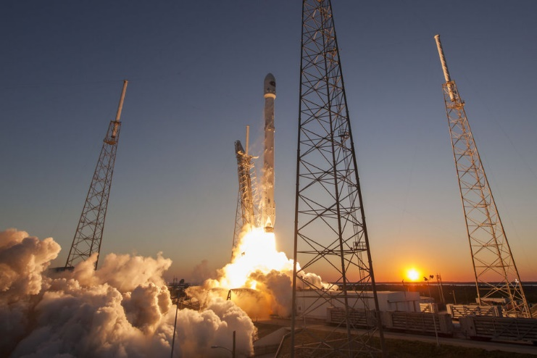
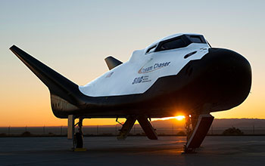
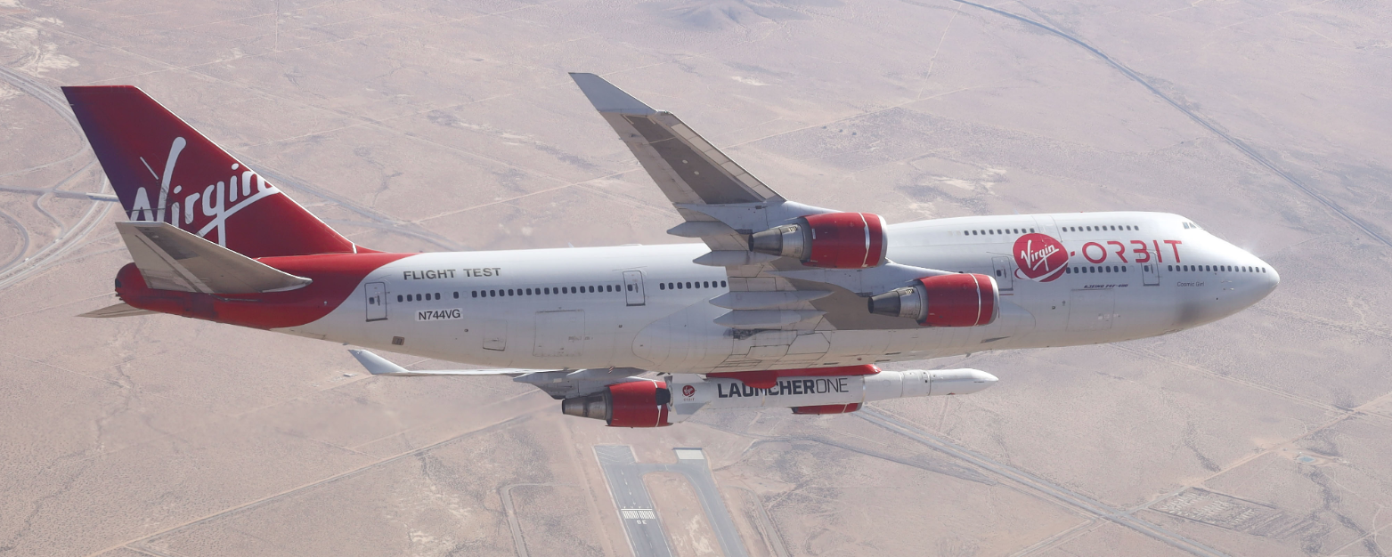
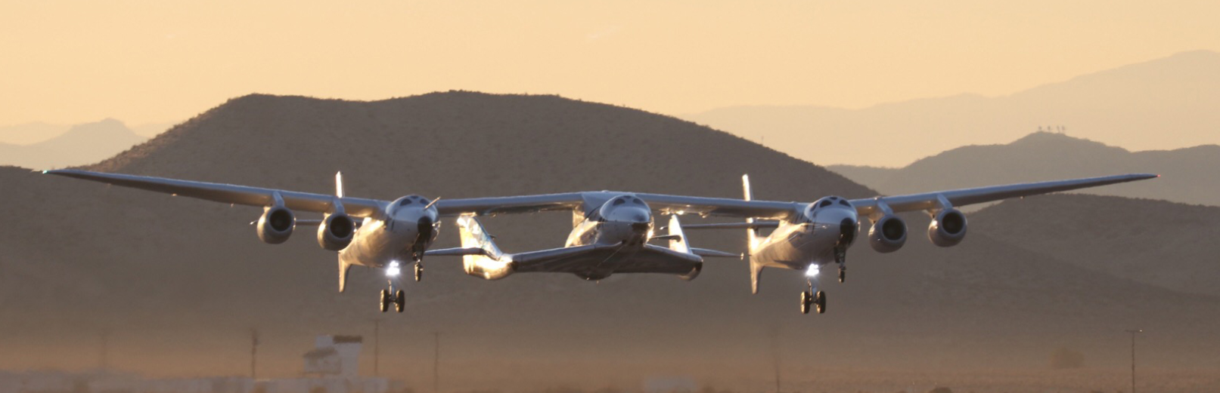
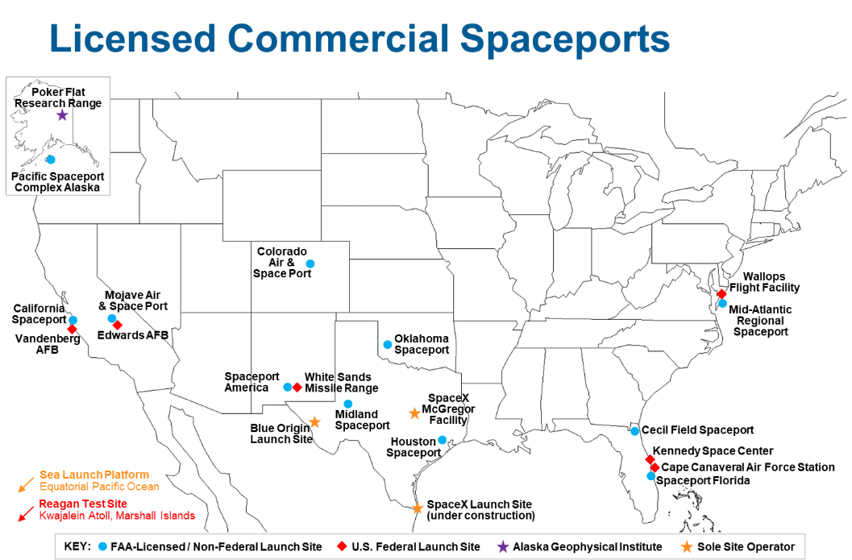
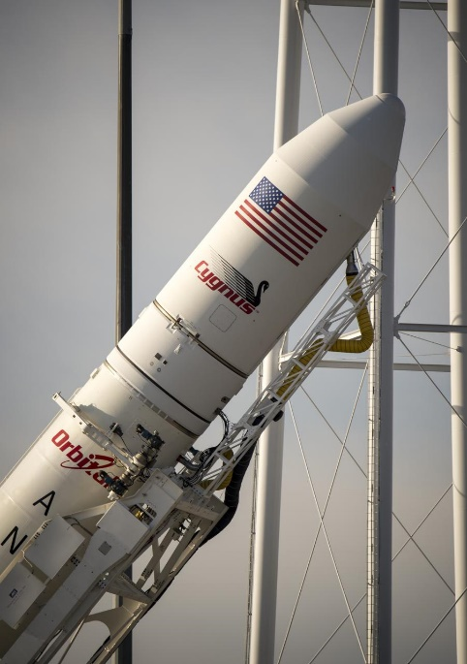
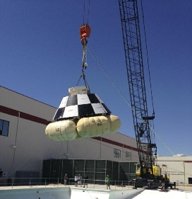
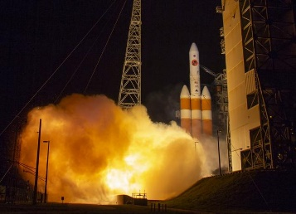
Commercial Space Industry is Vibrant New Operators, Innovative Operations from Increasing Number of Locations
SPACEX Image
Sierra Nevada Corporation Image
Virgin ORBIT Image
Virgin GALACTIC Image
MITRE Image
MITRE Image
NASA Image
NASA Image
NASA Image

Slide 3
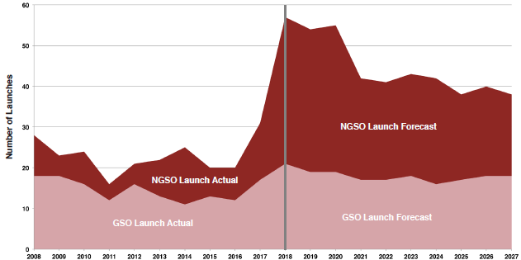
Historical and Projected Commercial Orbital Launch Trends
Historical and projected commercial orbital launches by orbital destination.
Source: FAA Compendium, 2018
Trends show operations peaking last year, project a decline in the year 2021 and steady after that. Innovative technology, new business opportunities and market forces may change the future trends.

Slide 4
FAA Evolving Strategy for Managing Air and Space
Current
Interim
Future
Segregated Airspaces
Preemptive Airspace Closure
Large Static Areas
Blocked for entire planned time window
Relatively higher number of aircraft may be affected by closure
Dynamic Hazard Areas
Hazard areas shape and activation based on vehicle location
Requires telemetry data exchange between space operators and FAA
Relatively fewer aircraft affected
Optimized Integration
Space vehicle and aircraft share same airspace
Focus on maintaining separation between aircraft and vehicle
Very few aircraft may be affected

Slide 5
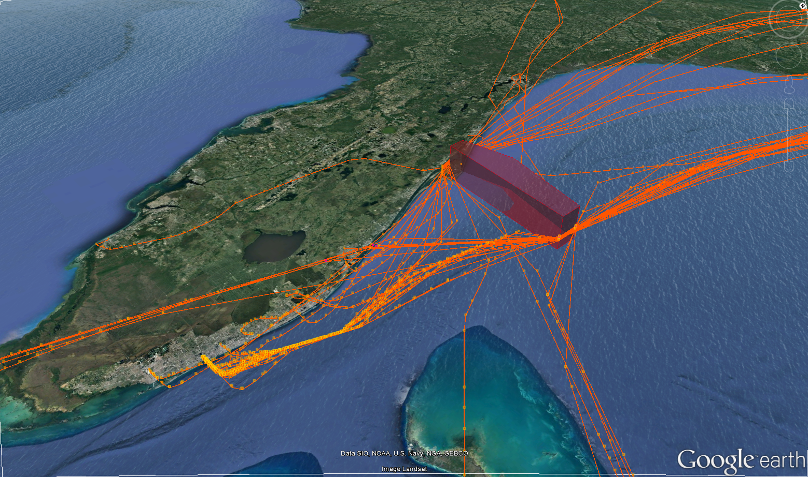
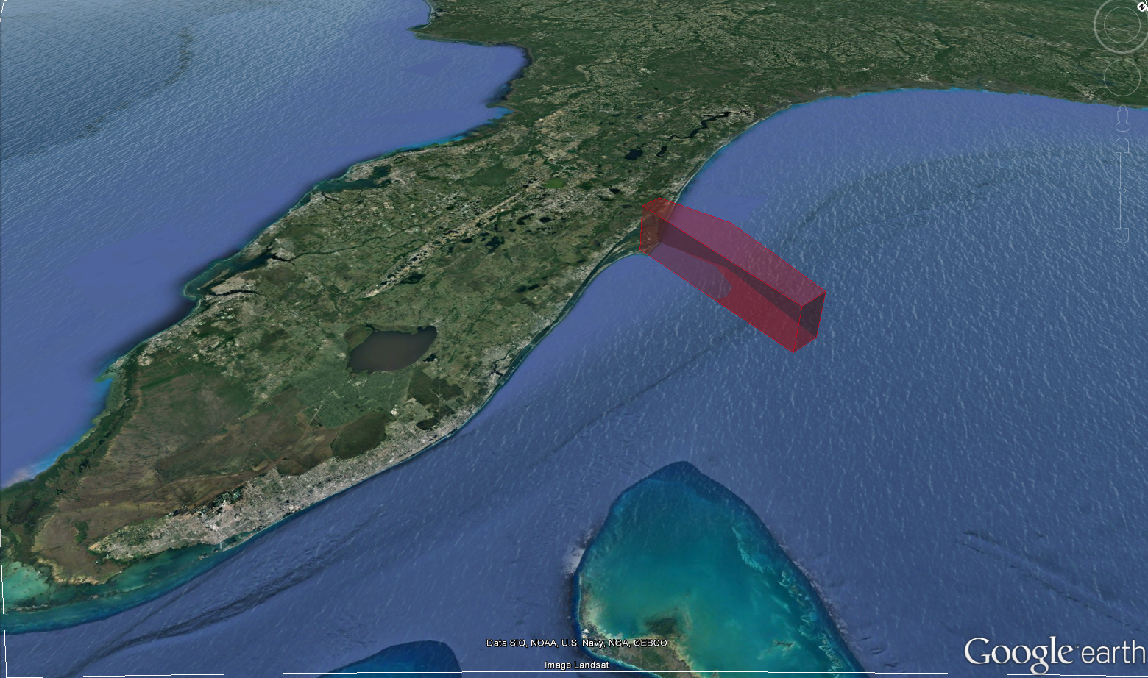
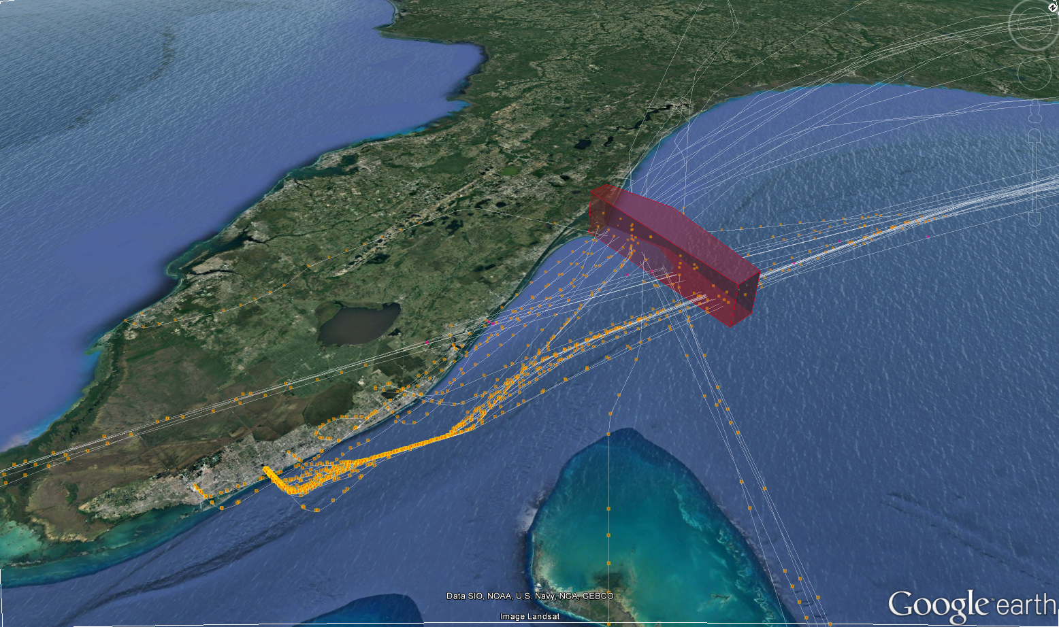
Understanding NAS Effect of Blocked Airspaces
Understanding NAS Effect of Blocked Airspaces
Understanding NAS Effect of Blocked Airspaces – Deep Analysis
Understanding NAS Effect of Blocked Airspaces – Operational Impact
Understanding NAS Effect of Blocked Airspaces – Economic Impact
March 8, 2018 1200-1400
Need to block the airspace between 1200Z-1400Z on March 1, 2018
March 1, 2018 1200-1400
Anticipated Number of Flights Affected | 60
Anticipated Number of Flights Affected | 60
Extra Distance Travelled | 2000 nm
Aggregate Delay | 485 min
Anticipated Number of Flights Affected | 50
Extra Distance Travelled | 1700 nm
Aggregate Delay | 429 min
Airline Cost | 28,000 $
Anticipated Number of Flights Affected | 60
Extra Distance Travelled | 2000 nm
Aggregate Delay | 485 min
Airline Cost | 31,200 $
Launch tentatively planned for March 1, 2018 during 1200Z -1400Z requires airspace to be blocked off Cape Canaveral

Slide 6
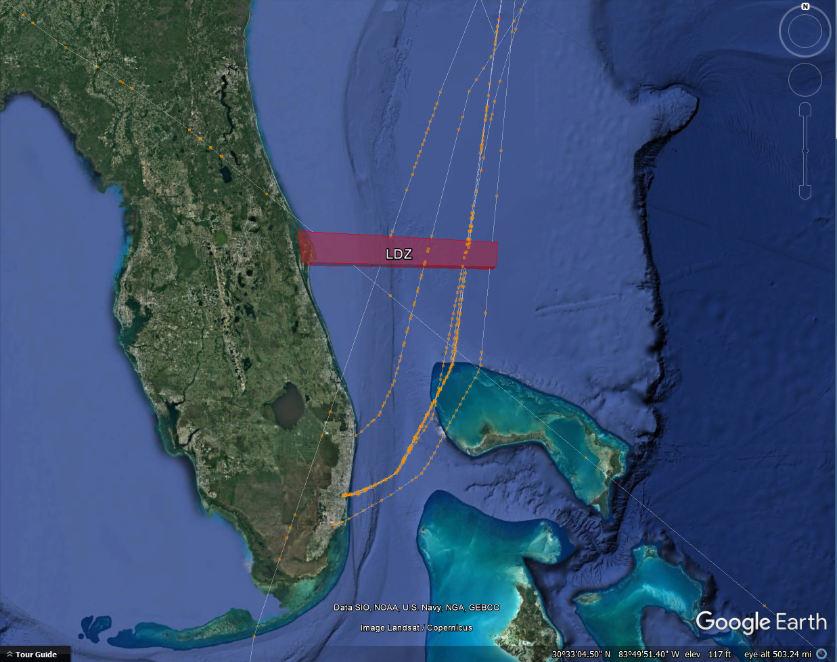
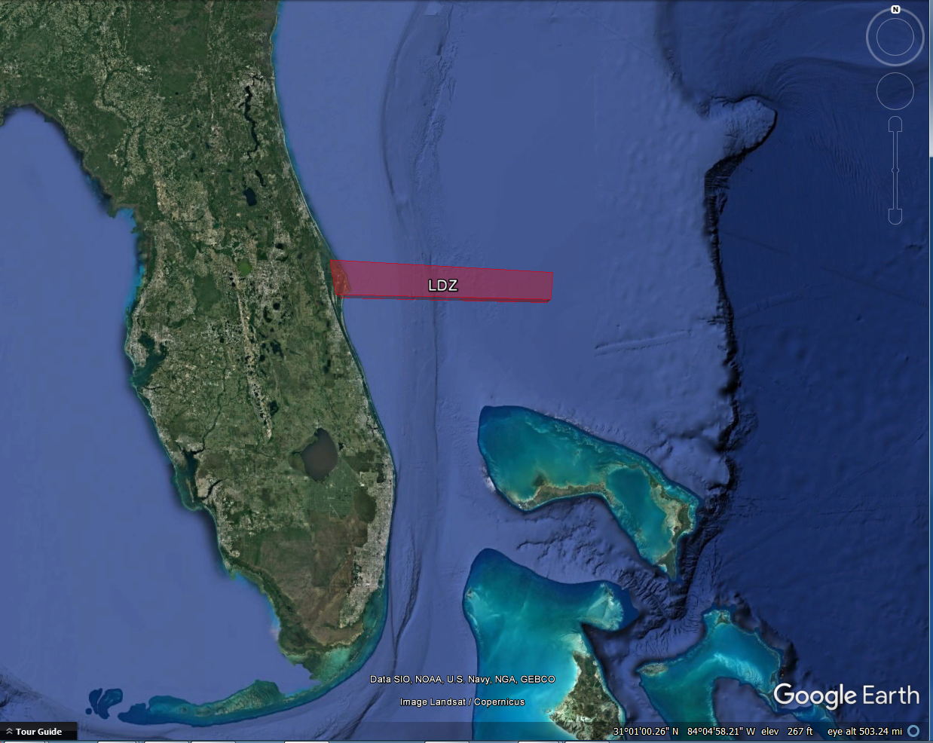
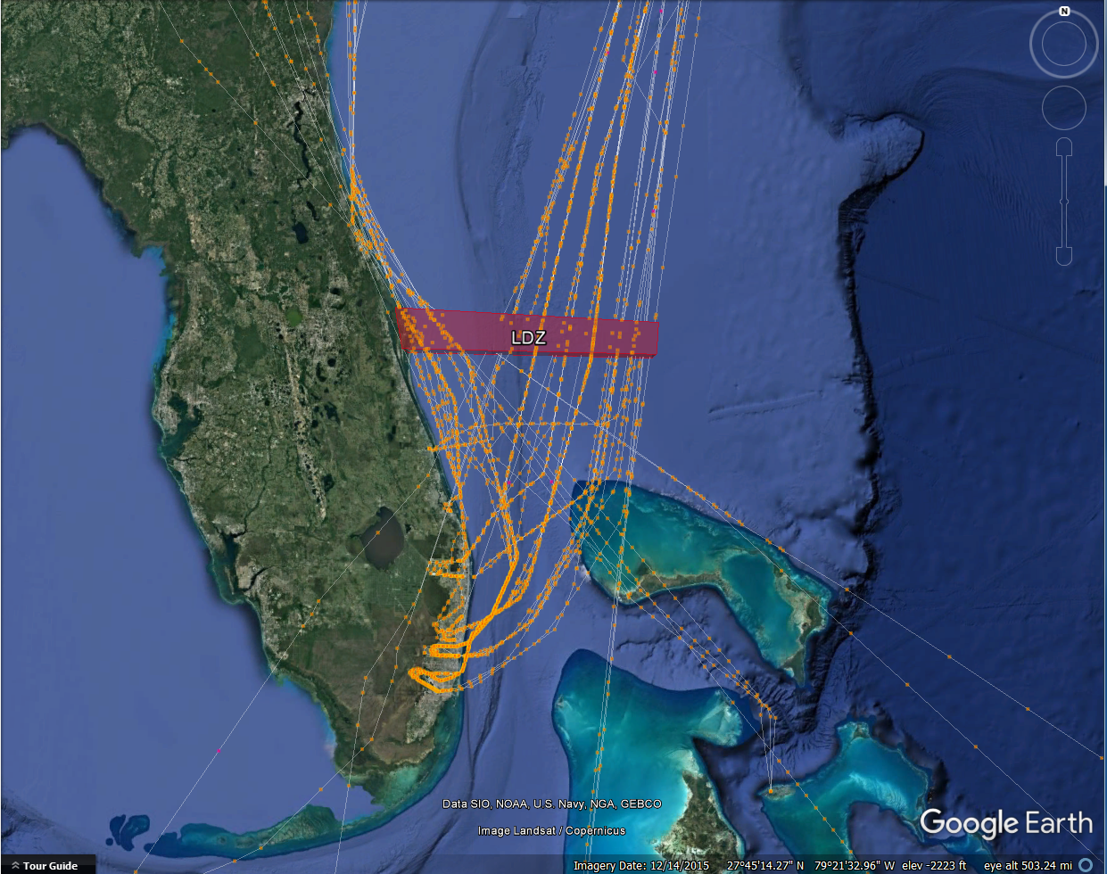
Use Case 1 – Space Operators Exploring Launch Time Options to Minimize NAS Impact
1200 | 1300 | 1400 | 1500 | 1600 | 1700 | 1800 | 1900 | 2000 |
1200 | 1300 | 1400 | 1500 | 1600 | 1700 | 1800 | 1900 | 2000 |
NAS Impact
NAS Impact
© 2019 The MITRE Corporation. All rights reserved. Approved for public release. Distribution unlimited. Case number: 18-4565.

Slide 7
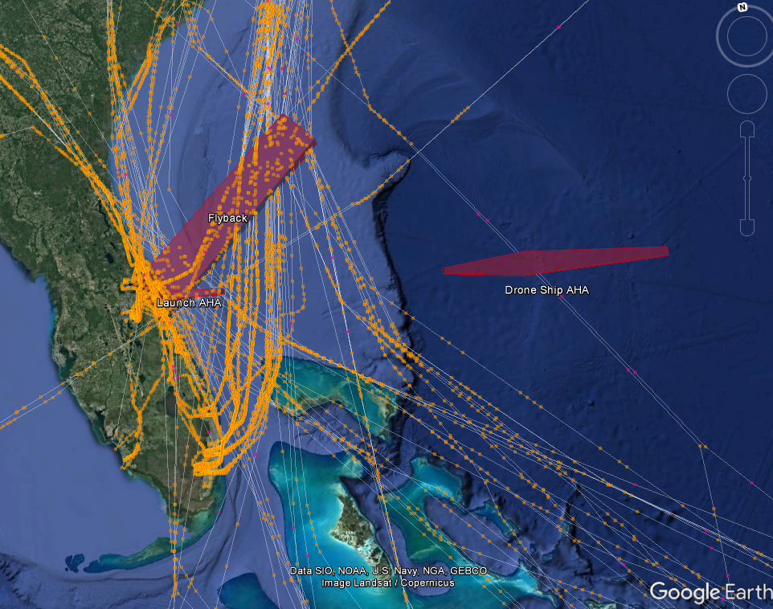
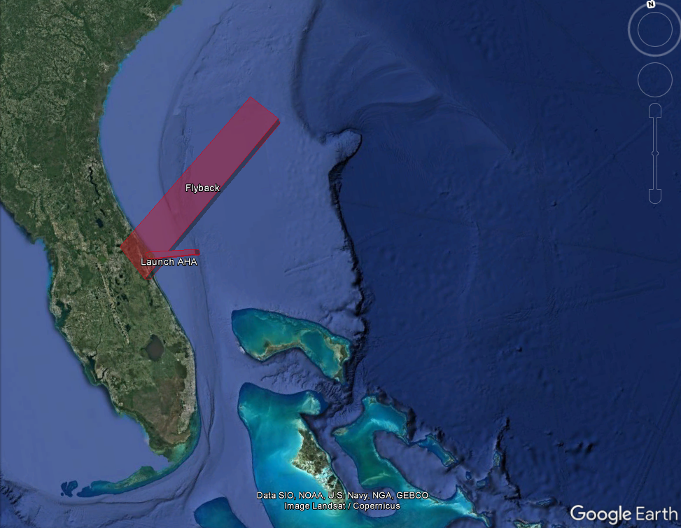
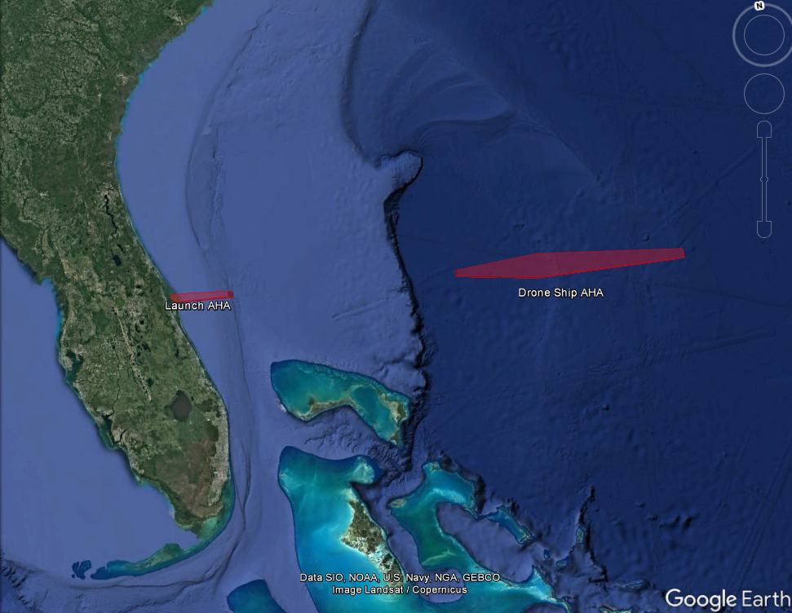
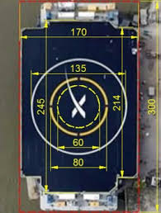
Use Case 2 – Space Operators Exploring Landing Options to Minimize NAS Impact
NAS Impact:
X
© 2019 The MITRE Corporation. All rights reserved. Approved for public release. Distribution unlimited. Case number: 18-4565.

Slide 8
Use Case 3 – FAA Assessing Impact
1200 | 1300 | 1400
Impacted Flights
X
© 2019 The MITRE Corporation. All rights reserved. Approved for public release. Distribution unlimited. Case number: 18-4565.

Slide 9
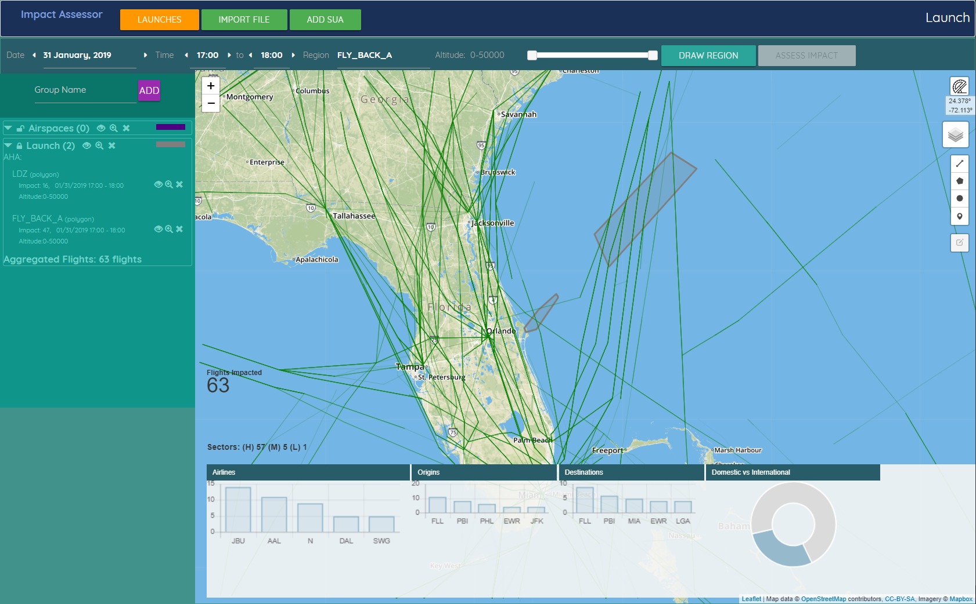
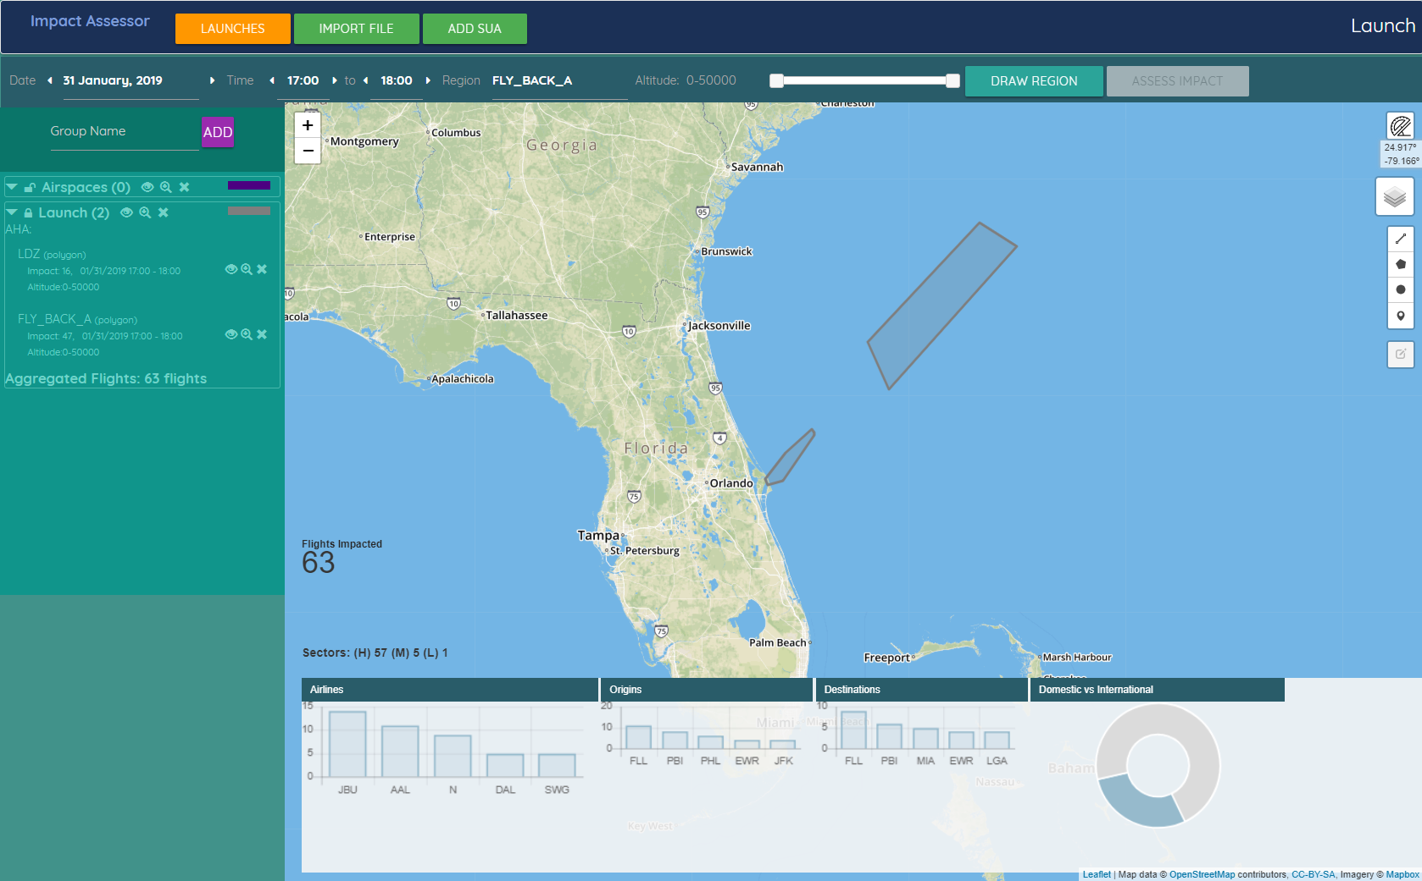
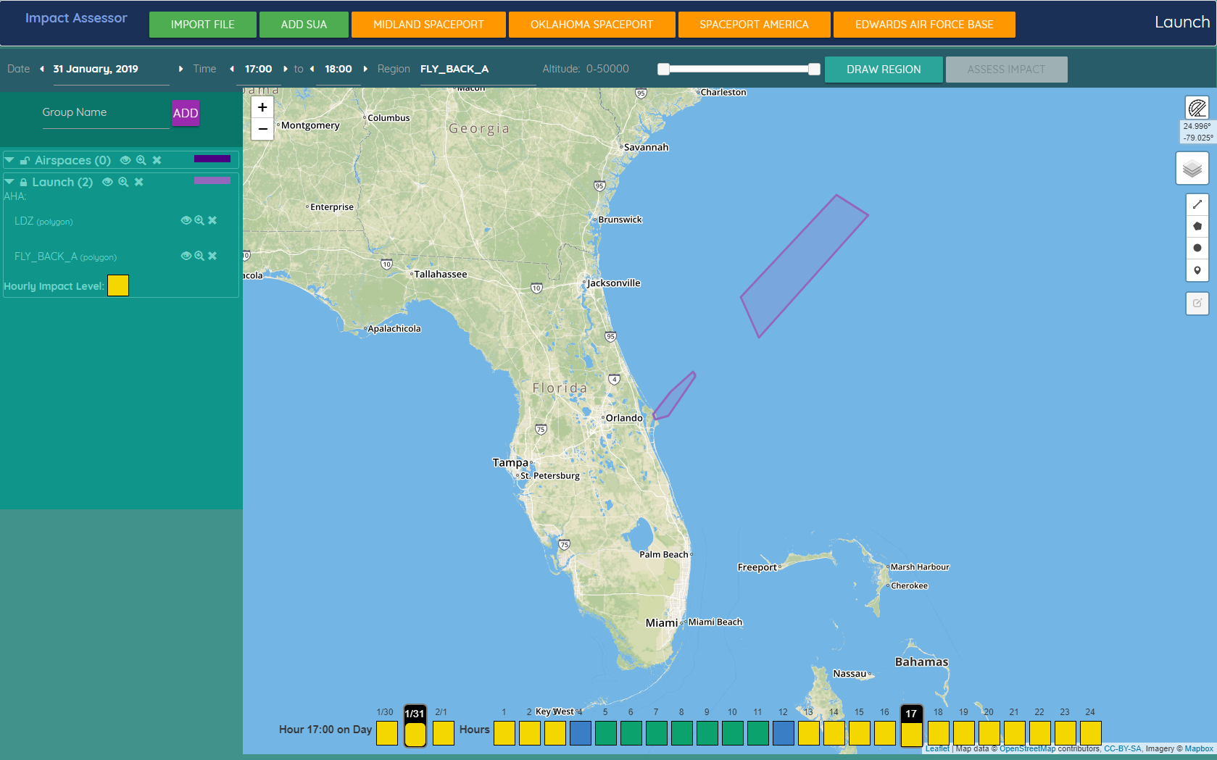
Rapid Impact Assessment (RIA) Prototype - NAS Effect Forecasting and Space Operation Planning Aid
Space Operator View
FAA Analyst View

Slide 10
Back-up

Slide 11
Forecasting the Effect of Space Launches on the NAS - In a Shifting Landscape
Uncertain space operation forecast
Evolving strategy to integrate space operations
Range of forecast of the effect of space launches on the NAS
+
=
Needs:
Analysis techniques to safely reduce airspace that needs to be closed
Planning tools to aid space operator plan operations during low airspace demand
Air traffic management techniques to reduce number of affected aircraft
Resilient ATC’s vehicle situational awareness for safety, responding to contingencies and quick release of airspaces
Practices and processes to share information and promote collaborative decision making

Slide 12
Dean Fulmer dfulmer@MITRE.org 651-226-6181

