Slide 1
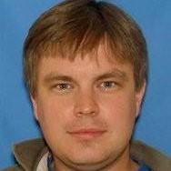
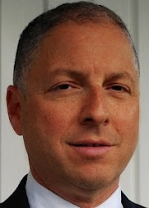
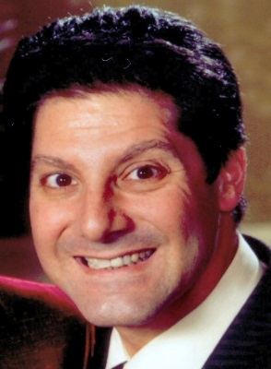
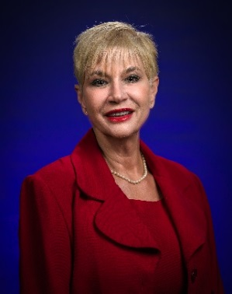
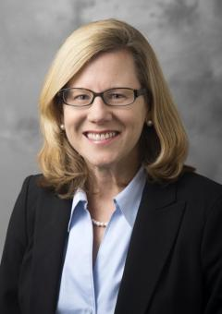
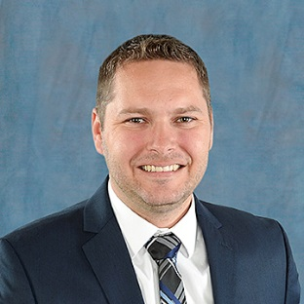
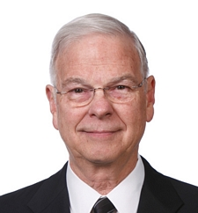
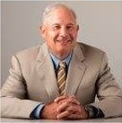
TRB 98th Annual Meeting, January 13-17, 2019, Convention Center, Washington, D.C.
Subcommittee on Commercial Space Transportation (CST), Transportation Research Board (TRB), National Academy of Sciences
1. Dr. Marcus Smith, The MITRE Corporation – Subcommittee Chair
2. Siegy Adler, Founder, SC Adler and Associates – Social Media
3. Dr. Ken Davidian, FAA-AST – Research
4. Dr. Diane Howard, Embry-Riddle Aeronautical University – Planning
5. Dr. Sarah Hubbard, Purdue University – Research
6. Ryan Nalty, Transport Policy Specialist
7. Richard Rogers, RS&H, Inc. – Membership
8. Bob Seibold, The Aerospace Corporation – Secretary
9. Dr. William Tippin, Webster University – Research
1
7
8
9
2
3
4
5

Slide 2
A DAY IN SPACE, 1 of 3
SESSION: Commercial Space Transportation to Low Earth Orbit and Beyond
Wednesday January 16, 8:00 AM - 9:45 AM
Convention Center, Room 143A Bob Seibold, Aerospace Corporation, presiding
PANELISTS:
Carlos Niederstrasser, Northrop Grumman Innovation Systems – “Comprehensive Update on Domestic and International Small Launchers”
Todd Master, DARPA/TTO – “DARPA Launch Challenge Update”
Sima Fishman, Euroconsult USA – “Satellite Demand for Small Launchers”
Dr. Ravi Chaudhary, FAA Office of Commercial Space Transportation – “Streamlining Licensing and Regulation of Commercial Launches, Reentries, and Spaceports” (withdrawn because of government shutdown)
Oscar Garcia, Chairman, InterFlight Global Corporation – “Development of International Standards by ASTM International Committee F47 on Commercial Spaceflight”
https://annualmeeting.mytrb.org/interactiveprogram/Details/10943

Slide 3
A DAY IN SPACE, 2 OF 3
SUBCOMMITTEE MEETING: Commercial Space Transportation, AV010(1), Joint Subcommittee of AV010, AV060, AV020
Wednesday January 16, 10:15 AM - 12:00 PM
Marriott Marquis, Treasury Room (Level 4)
Team presiding for Dr. Marcus Smith, MITRE Corp.:
Bob Seibold, Aerospace Corp.
Dr. Diane Howard, Embry-Riddle Aeronautical University
Dr. Ken Davidian, FAA Office of Commercial Space Transportation
GUEST SPEAKERS:
Dr. Micah Downing, Chief Scientist, Blue Ridge Research & Consulting – “Commercial Space Operations Noise Modeling and Measurements”
Richard Lamb, Aerospace Corp. – “Range of the Future (ROTF)”
Dr. Ken Davidian, FAA Office of Commercial Space Transportation – “Identifying the Needs of an Emerging Industry” (withdrawn because of government shutdown)
https://annualmeeting.mytrb.org/interactiveprogram/Details/9901

Slide 4
A DAY IN SPACE, 3 OF 3
SESSION: Behind the Scenes of a Commercial Space Launch
Wednesday January 16, 2:30 PM - 4:00 PM
Convention Center, Room 143A
Dr. Sarah Hubbard, Purdue University, presiding
PANELISTS:
Dean Fulmer, MITRE Corp. – “Forecasting the Effect of Space Launches on the NAS”
Dr. Steven Collicott, Purdue University – “Sub-orbital Experiments”
Chris Oswald, Senior Vice President for Safety and Regulatory Affairs, Airports Council International, North America, “Making Space for Space – Airport Operators’ Perspectives”
Stacey Zee, FAA Office of Commercial Space Transportation – “Environmental Challenges for Launch Activities” (withdrawn because of government shutdown)
Ariane Cornell, Blue Origin – “Marketing Commercial Space Activities”
https://annualmeeting.mytrb.org/interactiveprogram/Details/10947

